Slide 1


Using Social Media to Recruit

Slide 2

Key Takeaways
How to leverage social media to open up Scouting to kids and parents in your area.
How to Post and respond on at least one social media platform
How to post quality content.
Notes:
Social Media has a Broad reach. It is very accessible and Highly versatile. Comparatively inexpensive to alternative media advertising
Posts styles will be discussed by platform
Post regularly. Don’t go more than one week without an update.

Slide 3
General Strategy
Organize content
Integrate communications
Know your audience
Prioritize a single message, don’t overdo it
Use a personalized approach
Encourage communication
Target groups/demographics to the extent possible

Slide 4
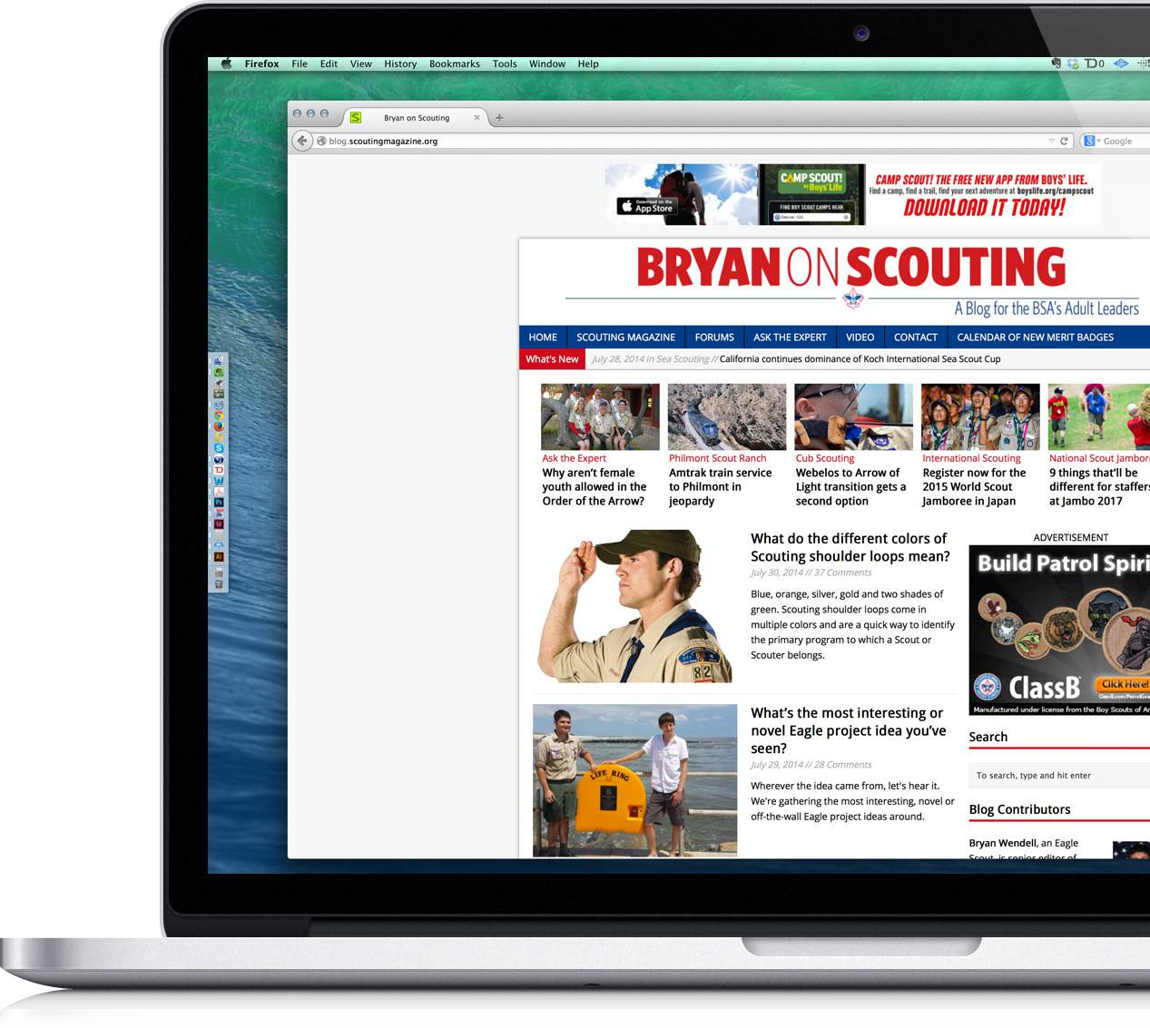
Blogging
Blogging is a way for you to keep readers informed about the latest in your area.
Did you hold a successful fundraiser?
Did you improve the neighborhood with a recent Eagle Scout project?
It doesn’t have to be more than a paragraph, but it should be timely and relevant (don’t wait three months to share the photos from last weekend’s camping trip).
This is your chance to tell readers why being a part of Scouting is so valuable.
Notes:
What to post on your blog!
Post interesting content. This is Scouting we’re talking about, so that’s not too hard. Camping trip reports, schedule updates, major events, and award announcements are all good examples of content worth posting.
Use images. Studies show people are 75% more likely to read a blog post that contains a picture or video than one without.
Show your appreciation when people participate. Acknowledge them in the comments or somewhere else on your blog.
Ask for participation. If you want people to interact with you online, you have to ask them what they think. Ending a post with a question, like “What are your thoughts about…” can,make a big difference.

Slide 5

Action Items to Help Ensure Your Blog is Relevant
Your entries should entertain, inform, and/or help visitors complete a task.
Get right to the point. A blog post is not a book; it’s a little blip of the Scouting experience.
Update your blog at least once every week.
Use information and content from BSA websites in your blog.
Notes:
Follow the following steps to ensure your blog is relevant.

Slide 6
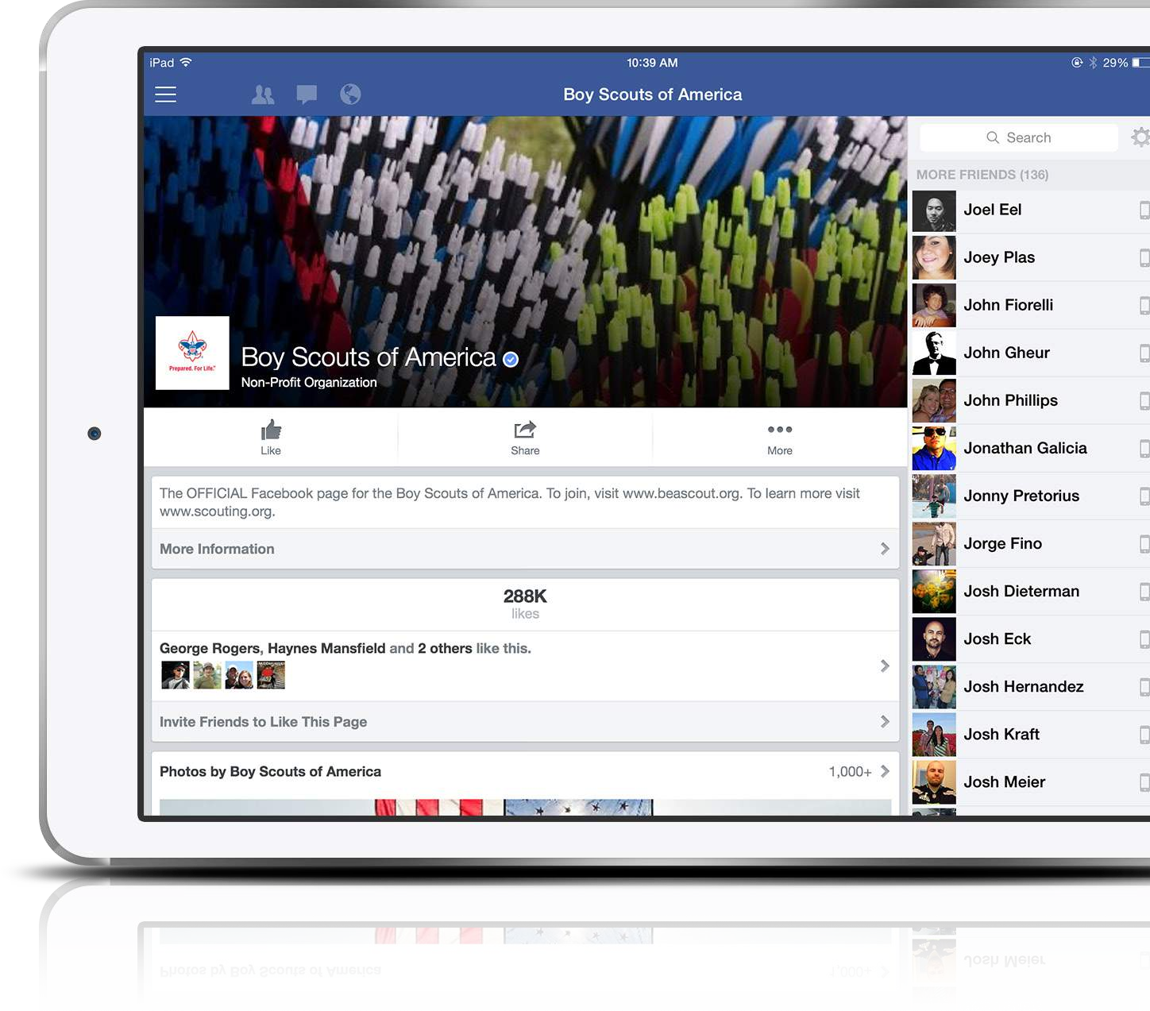
Facebook
Facebook is the world’s largest social website with 1.23 billion active users per month. It’s user friendly and makes engaging others in your community a relatively easy task. Plus, with that many users, it’s likely most people within your Scouting community are already involved.

Slide 7

33%
Increase
Using emoticons increases comments by 33%
100%
More Comments
Question posts get 100% more comments
Getting Started with Scouting on Facebook
You need to create a Facebook “Page.” This part of Facebook is your own personal Facebook profile.
Facebook makes this process as simple as possible by walking you through easy-to-follow directions and descriptions.
Invite your Scouting community to “Like” the page, and start populating it with quality content.
If you’re having trouble getting set up, Facebook has a ‘Help’ section with tutorials and detailed directions.
23%
More Interaction
Shorter posts get 23% more interaction
Notes:
What to post on Facebook
Whenever possible, post pictures or video. Photo posts get 39% more interaction. If you’re lacking content, you can go to the BSA Flickr page and scour our new image library. Once you find something you like, download it and post away!
Post when your audience is likely to be on Facebook, typically right before lunch or right after rush hour. Respond to people who respond to you. It’s the golden rule of social media.
Share content from other Facebook Pages often, especially the BSA Facebook Pages. There is a lot going on in Scouting. The more you share, the better.

Slide 8

Instagram
With over 150 million users, 16 billion photos shared, and 1 billion likes happening each day, Instagram photo and video sharing is one of the most engaging channels on social media. You can share pictures and short videos with those in your network, giving them a glimpse at what Scouting has to offer.

Slide 9

33:1
What Makes InstagramUnique
Instagram is phone-only. You can’t post to Instagram from a computer. You can, however view Instagram on your computer.
Instagram is designed to integrate easily into your Facebook and Twitter accounts.
Uses image filters. As soon as you choose an image to post, Instagram will direct you to a menu of easy-to-use options to treat
your photos.
There’s no text at all in the Instagram app. Don’t be afraid of the icons, just use them and explore.
Comment Ratio
For every 33 likes you get 1 comment, on
average
#
Use Hashtags
More hashtags equal more engagement #trustus #theywork
Post on
Sunday
Sunday posts have the highest engagement
Notes:
What to post on Instagram
Add hashtags to your image descriptions. Pictures with hashtags get nearly double the amount of interaction as those that don’t.
Follow people, and like their content. There’s a big you-scratch my-back-I’ll-scratch-yours element to Instagram. If you want interaction, you need to interact.
Choose a filter and make it your own. It’s fine to use different filters for different images sometimes, but if you want people to learn to recognize that a picture is coming from you just by looking at it, choose one and stick with it.
Use Instagram video. Instagram will allow you to take 15-second videos and post them to your account. One thing you can’t do, however, is post video from other platforms like YouTube.).

Slide 10
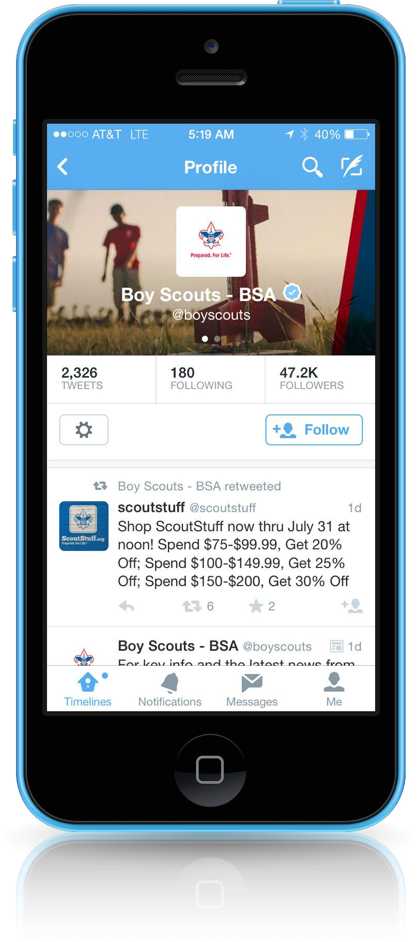
Twitter
Twitter is the world’s most popular platform for “microblogging.” In other words, if you can’t get your point across in 140 characters or less, this isn’t the platform for you. Twitter is about quick updates, reminders for events, or powerful quotes that can motivate and inspire. The key to making Twitter successful is to keep content timely and relevant.

Slide 11

Pinterest
Welcome to the visual web. Pinterest is a virtual ‘pinboard’ where users can save things they’ve found online to keep track of them.

Slide 12
TIPS FOR OPTIMIZING YOUR EMAIL
Subject Line Strategy
Your email subject line is the first impression of your message. It’s your first chance to catch your reader's interest and draw them in.
Don’t Forget about Mobile
More than half of emails are read on either smartphones or tablets.
Engaging, Useful, Short and Sweet
This may seem like a no-brainer, but writing content that will be interesting and useful to your readers is paramount. Focus on highly relevant, bite-size content.
Segmentation
The more you can send highly targeted and relevant content to your audience, the more they will engage.
Optimize with A/B Testing
Don’t assume you know how your audience will respond. Test subject, sender name, content and more!
Ditch the Dis-Engaged (List Cleaning)
Don't send email to people who never have and probably never will engage.

Slide 13
SMS/TEXTING
Email is like the older brother — classic and dependable. He’s already proven himself and is generally well-liked and accepted.
SMS is the younger, shorter, brother — hip, trendy, and loves the latest tech fads. He’s quick to action and eager to prove himself, which may turn some people off. But, for the most part, he’s starting to become more accepted and earn his place in the world.
Outbound SMS
Inbound SMS
Event Reminders
Promotions/Contests
Urgent Notifications
Personalized Reminders
Text 'join' to 313131
Text to give
Email list sign up

Slide 14


Other Tools
Press releases –
TapInto
Patch.com
Route94.com
Straus News
Notes:
Check for your local newspaper or share site. They will share or post press releases that are focused on their town and community.
TapInto has a fee, to avoid $20 fee for “Non-Profits”, select “Government Agency”, most TapInto editors will accept

Slide 15
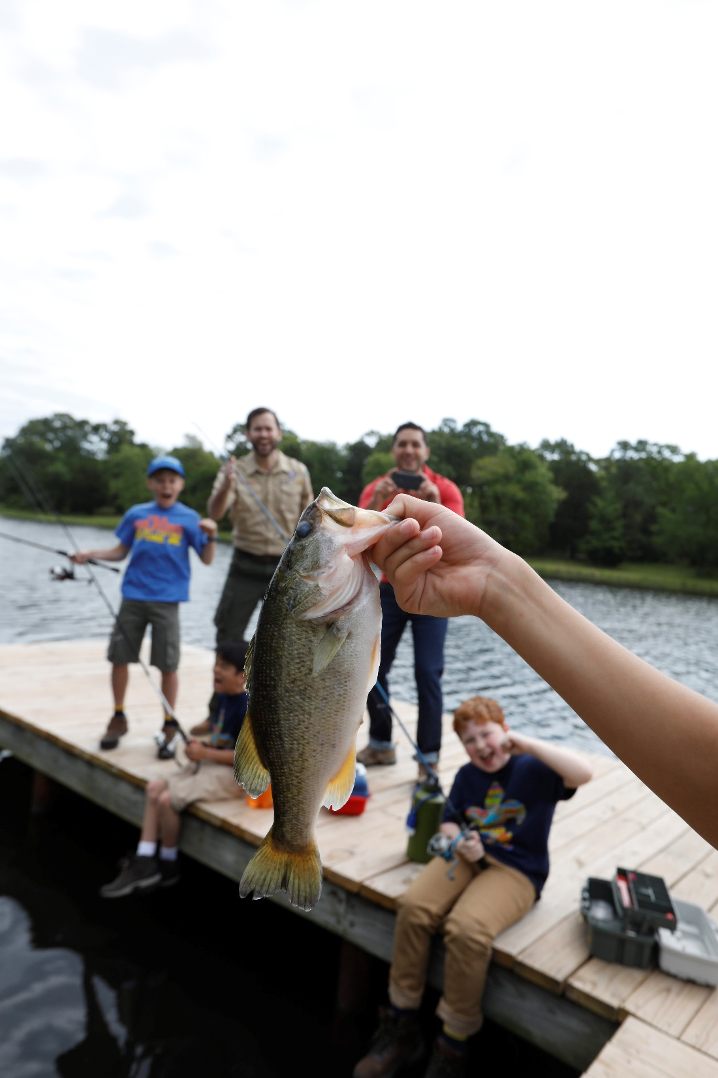
PR STRATEGY
BE
SHOW
TELL
    A story is great.
    An experience is even better.

Slide 16
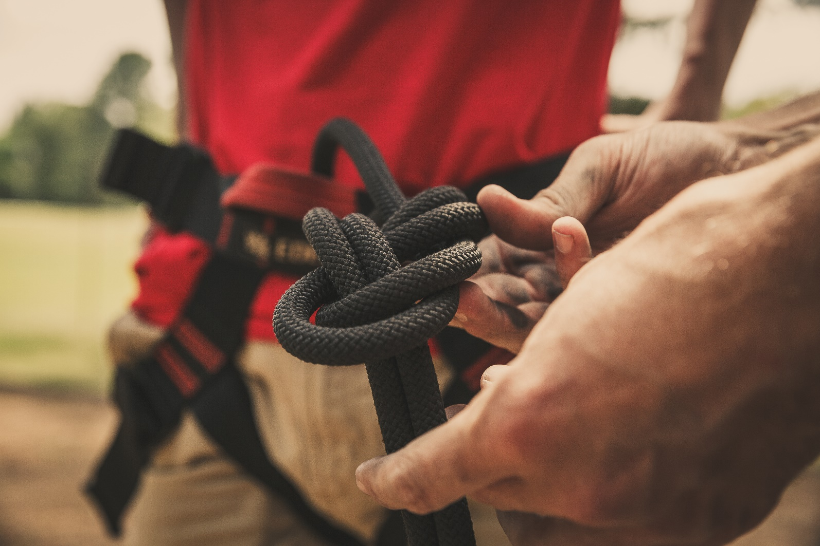
THE STORY
Start close to home
Mediable moments
    Firsts
    Community activities
    Good news stories
Notes:
Source them from your own community
Reach out to local EA leaders and start a dialogue to find out what pack activities they have coming up.
Develop a list of key opportunities that would be “media-able”
The media loves “firsts.” Are there any “firsts” for your community? (first girls in a pack, first girls holding Pinewood Derby/Raingutter Regata, first girls completing service projects, first girls advancing

Slide 17

CAPTURE
COVERAGE
DVR
Download
Ask
Acquire
Keep for your records!
Notes:
Capturing media coverage
Set your DVR (if you know when something will air, share the air date with key audiences so they can watch live)
Depending on your relationship with your media, you could ask them for a digital copy of the story that was aired
Use a media video capture service
If story is print, pick up a few copies of the print version to share with key stakeholders
If story is digital, capture links
Make a .pdf or permanent version for your own records as digital versions of stories are sometimes archived or removed by media

Slide 18

RESHARE CONTENT
Repackage the story for your audiences
Embed videos on web page
Create a blog post
Share links on social sites
Encourage sharing
Send out
Share in presentations
Notes:
Package and re-share the media story with key audiences
Ask the media to submit the story to their affiliates nationally (in some cases, depending on the nature of a story, a local media outlet may submit their local story to their other affiliates for increased broadcast distribution)
Embed media videos on a council webpage or blog
Share local news links as posts on your own social channels
Re-purpose/re-write local media coverage on your own council blog/website, and share that link via your social channels
Encourage sharing via key volunteers on their social channels
Summarize the story and include links to videos in your regular e-mail newsletters to your community
Share the story (video, photos, and/or description) in presentations to volunteers, local community groups, others
Send as contributed content to ScoutingWire for national story consideration

Slide 19
Considerations
Follow the BSA Social Media Guidelines
Remember to strictly adhere to the terms of service and existing guidelines for each respective social media
Designate an administrator for the page or account
Avoid giving out personal information on public pages or forums
Monitor content and remove any highly offensive posts
Be prepared to respond to negative or inaccurate posts if warranted
Direct media inquiries to the appropriate Council designee

Slide 20
Questions?

