Slide 1
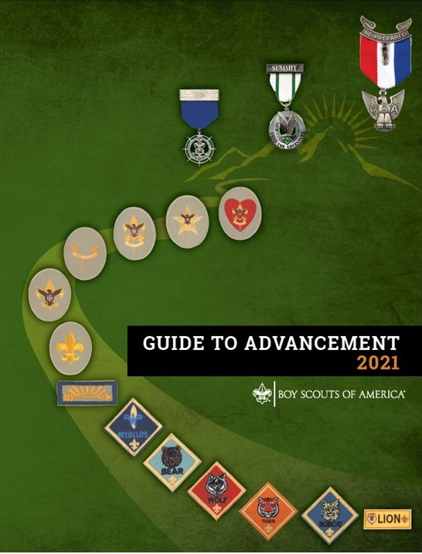
Introduction to the
Guide to Advancement
National Advancement Program Team
(with edits by Michael Merritt)
Expiration Date
This presentation is not to be used after January 31, 2021.
Obtain an updated version at www.scouting.org/advancement
Notes:
Welcome everyone and thank them for attending. They could be doing something else with their time, but they chose to be at this presentation.
Challenge participants to ask questions and encourage them to join in the discussions.

Slide 2

The Guide to Advancement
The Official Source for
Advancement Administration
The Guide to Advancement is the official source for the administration of advancement for all programs of the Boy Scouts of America.
Statements or interpretations offered by unofficial sources may be out of date or incorrect.
First direct your questions to experienced district or council advancement administrators. Then to the National Advancement Program Team (Advancement.team@scouting.org)
Notes:
The Guide to Advancement is the official source for the administration of advancement in the Boy Scouts of America.
Bryan’s Blog, Scouting Wire, Scouting Magazine, and Advancement News are also official sources of information.
Other sources (unit, district, council websites, meritbadge.org, usscouts.org, etc.) are not official and may contain incorrect or outdated information.
When you have questions regarding advancement procedures first, check the Guide to Advancement. Next, direct your questions to your local experienced district or council advancement administrators.
Finally, you can direct your questions to the National Advancement Program Team at Advancement.team@scouting.org.

Slide 3
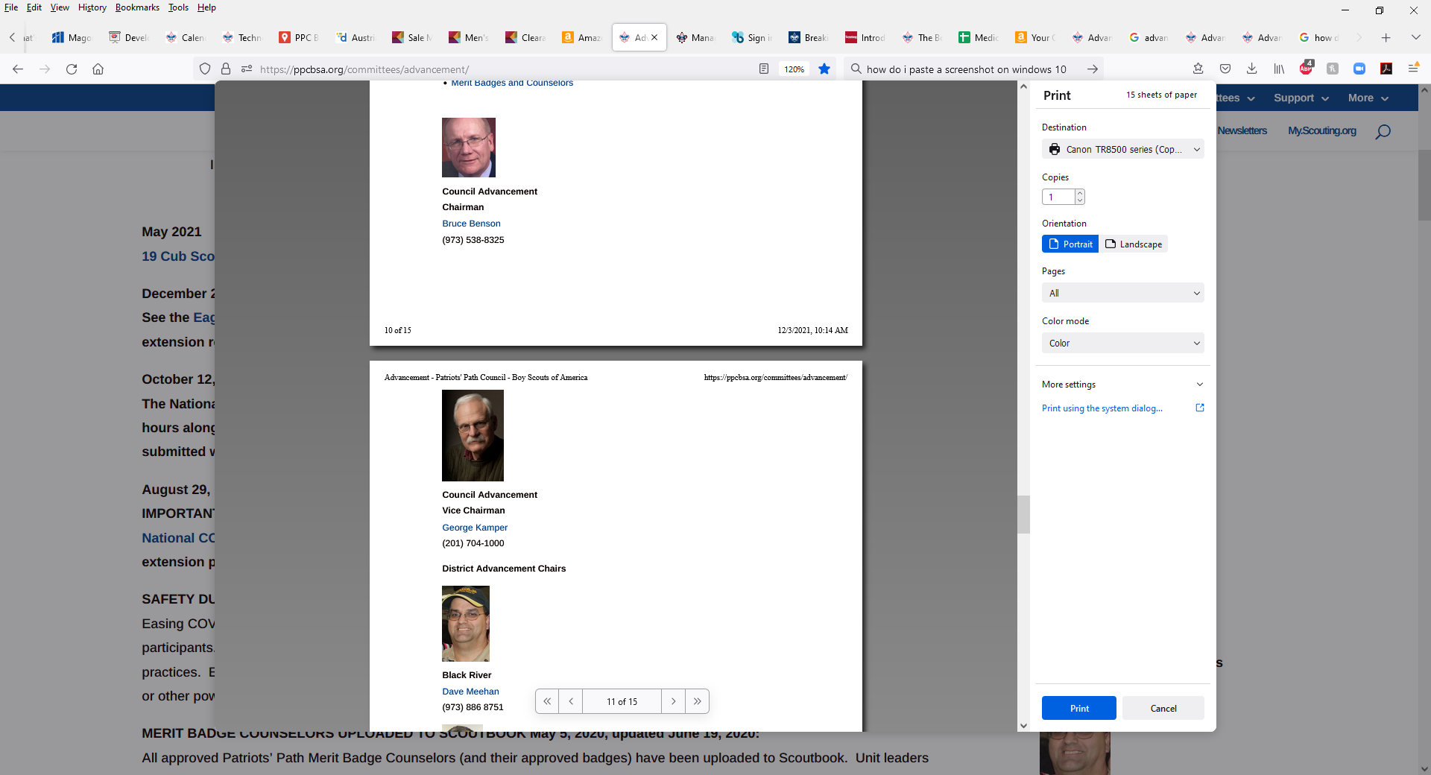
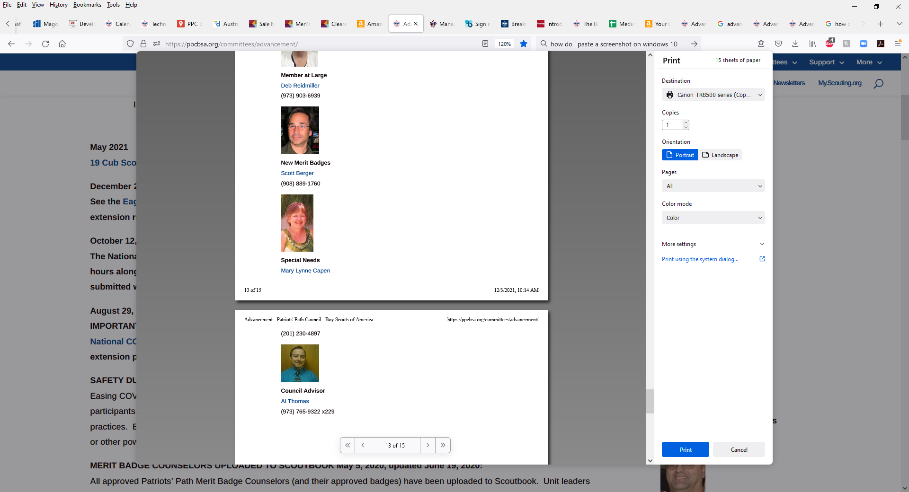
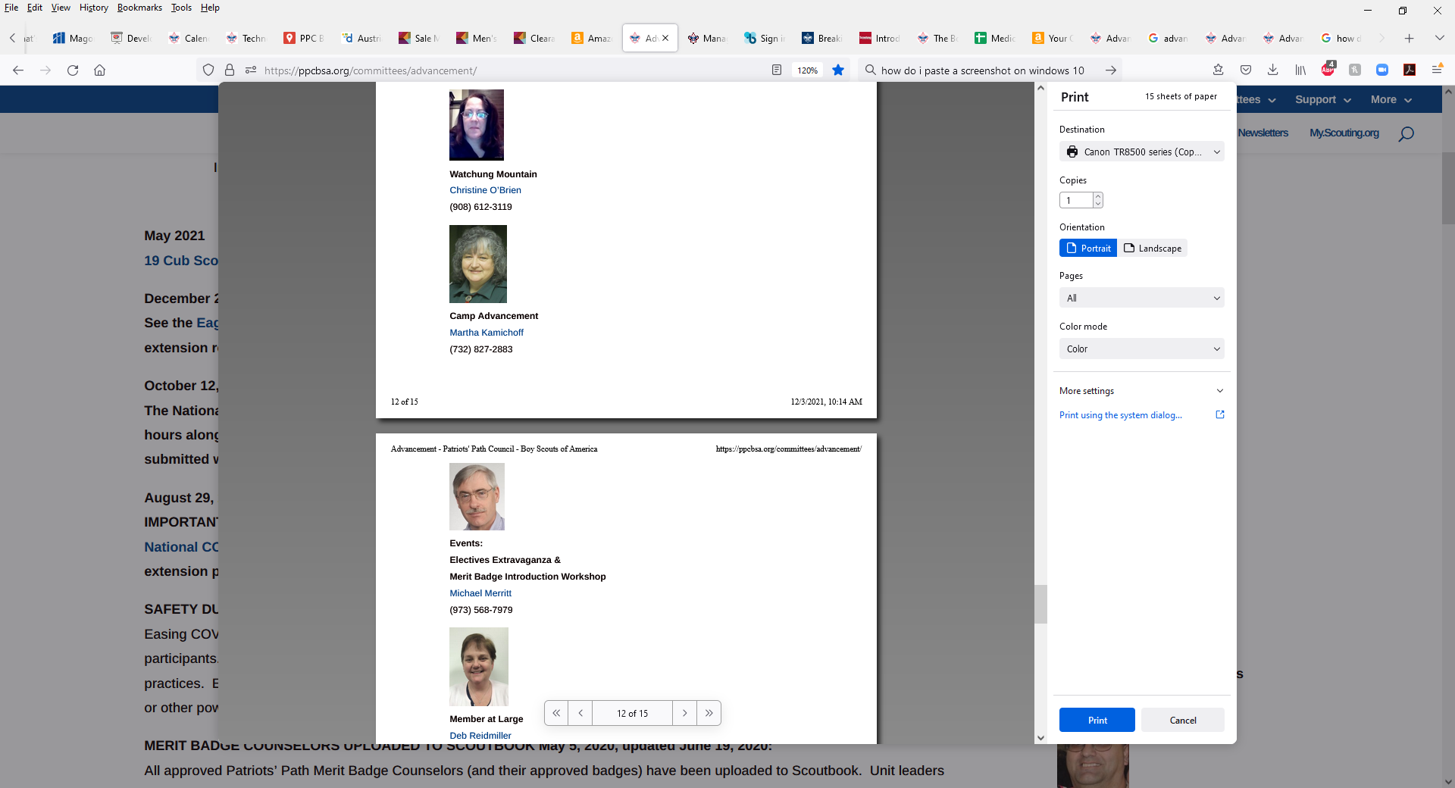
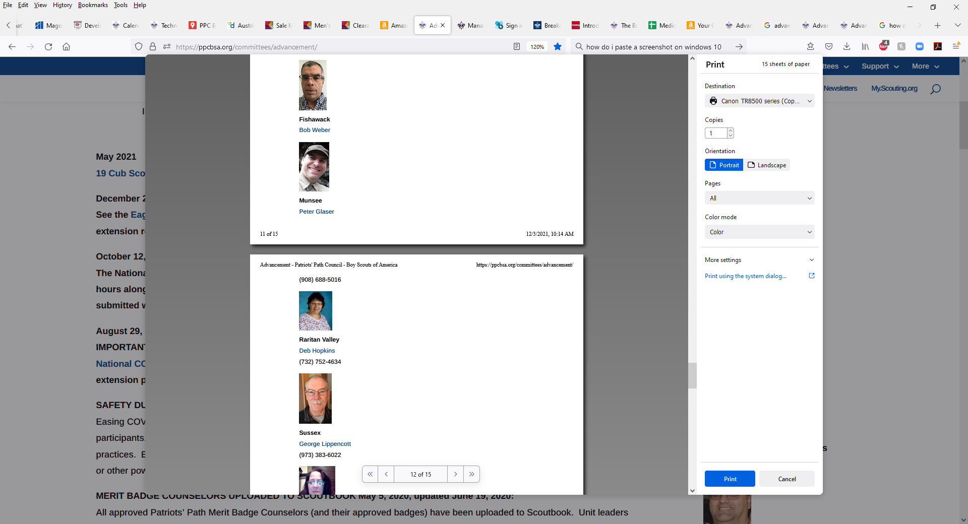
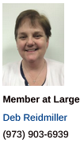
PPC Advancement Committee
ppcbsa.org/committees/advancement

Slide 4
The Guide to Advancement
Development
Producing the Guide to Advancement involves many volunteer advancement administrators at all levels from across the country and many members of the Boy Scouts of America national staff.
The Guide to Advancement is usually published every two years or more often when major program changes occur. If changes occur during the print cycle, updates may be found at https://www.scouting.org/resources/guide-to-advancement/
Always be sure you have the latest edition of the Guide to Advancement when dealing with advancement issues.
Notes:
Producing the Guide To Advancement involves many experienced Scouting volunteers and professionals from throughout the country. Before the GTA is published, extensive reviews occur at many levels of the National office of the BSA.
The Guide to Advancement is usually published every two years. However, changes in the Scouting program or requirements may require re-publication more often than every two years. In some cases where the change may be significant, the online version is updated. Advancement News and @AdvBSA will announce if a change has been made to the online version.
This is why you must be sure you are using the most recent edition of the Guide to Advancement when dealing with advancement issues.

Slide 5
The Guide to Advancement
Mandated Procedures and
Recommended Practices
Mandated procedures are identified with words such as “must” and “shall”. Where such language is used, no council, committee, district, unit or individual has the authority to add to or subtract from the advancement requirements.
Recommended best practices are identified with words such as “should”, “may’, or “can. Refer questions on these to your district or council advancement committee.
Notes:
As previously stated, the Guide to Advancement is the “law of the land” when it comes to advancement in the Boy Scouts of America.
It is the policy of the Boy Scouts of America where the words “must” or “shall” are used in the Guide to Advancement where no council, district, unit or individual has the authority to add to or subtract from these mandated requirements.
Where the words “should”, “may, or “can” are used in the Guide to Advancement, the procedures are recommended best practices but may be modified, with good reason, after consultation and approval of your district and council advancement committee.

Slide 6
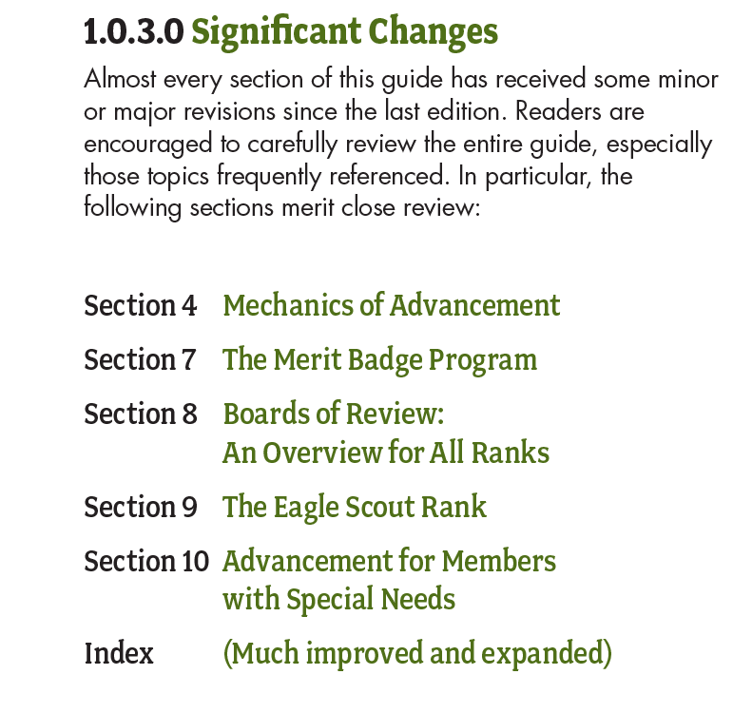
2021 Updates

Slide 7

2021 Updates
August 2, 2021
Online Scoutmaster conferences are OK but not preferred
The definition of a ‘month’ gets clarified
Alternatives to merit badge ‘blue cards’ allowed
More guidance given on what to do when merit badge requirements change
Eagle Scout boards of review can occur up to 24 months after the 18th birthday
Venturing, Discovery, Pathfinder and Summit are now ranks, not awards
Venturing board of review decisions must be unanimous
Sea Scout ‘bridge of review’ now called ‘board of review’
Process for Eagle Scout time extensions modified
Guidance for Cub Scouts who are home-schooled or educated in nontraditional ways
Index revamped

Slide 8
The Guide to Advancement
Mandated Advancement Practices in Camp or in Merit Badge Programs
There are no camp or merit badge fair–related exemptions, mandated procedures must be followed.
The requirements must be completed exactly as written.
A Scout must actually and personally complete the requirements.
If requirements cannot be completed, as written, in camp or a fair, they must be completed elsewhere.
Notes:
Here is an example of how mandated procedures are identified and defined and should be followed.

Slide 9
The Guide to Advancement
Main Sections
Introduction
Advancement Defined
Guidelines of Advancement and Recognition Committees
The Mechanics of Advancement
Special Considerations
Electronic Reporting
The Merit Badge Program
Boards of Review – All Ranks
The Eagle Scout Rank
Advancement for Members With Special Needs
Notes:
Here are the main sections of the Guide to Advancement. They cover the entire spectrum of advancement policies and procedures.

Slide 10
The Guide to Advancement
Indexing System
Organized by Section, then main topic, then detailed information numbered consecutively.
Example:
  Section 4.0.0.0 Mechanics of Advancement
  4.2.0.0 Mechanics of Advancement in Scouts, BSA
  4.2.3.4 Positions of Responsibility
  4.2.3.4.1 Positions Must Be Chosen From Among Those Listed.
Notes:
Here is how the indexing system in the Guide to Advancement works.

Slide 11
The Guide to Advancement
Ease of Use
Numbered and organized for easy reference.
It presents a list, by section, and a description of significant changes made since the last GTA publication.
Frequently asked questions are listed and referred to the GTA section where the answer can be found.
It has an extensive, helpful appendix.
Free PDF version is available.
Notes:
The Guide to Advancement is structured to be easier to use than earlier advancement publications.
A list of frequently asked questions, the indexing system, and a helpful appendix are intended to speed use of the Guide to Advancement.

Slide 12
The Guide to Advancement
Section 2,The Advancement Method
Advancement is one of eight methods necessary to realize scouting success
Advancement is nothing more and nothing less than a method. It is a means towards accomplishing the Boy Scouts of America mission and objectives. It is not an end in itself.
As a method, Advancement supports the four objectives of Scouting: character development; citizenship training; leadership; and mental and physical fitness.
Notes:
Let’s now look at some of the main topics of each Section of the Guide to Advancement.
MISSION STATEMENT
The mission of the Boy Scouts of America is to prepare young people to make ethical and moral choices over their lifetimes by instilling in them the values of the Scout Oath and Law.
The eight methods of the Scouting movement are the means through which the Aims of Scouting are achieved:
Scouting Ideals.
Patrols.
Outdoors.
Advancement.
Personal Growth.
Adult Association.
Leadership Development.
Uniform.

Slide 13
The Guide to Advancement
Section 3, Advancement Committees
Outlines responsibilities for Council, District and Unit Advancement (and Recognition) Committees
Gives suggestions for building Council and District Advancement Committees, and for organizing responsibilities at the unit level.
Describes awards and recognitions administered at the Council or District level.
Notes:
Section 3 outlines the responsibilities of council, district and unit advancement committees in order to assist Scouts advance.
The Section describes possible committee organizational structures to complete committee responsibilities and also describes training available to assist new advancement administrators learn how to successfully conduct their responsibilities.

Slide 14
The Guide to Advancement
Section 4,The Mechanics of Advancement
The philosophy of age appropriate learning, age requirements, the ranks and their requirements which a Cub Scout, a Scout, a Venturer, or a Sea Scout may earn, and the role of adults and leaders in the process.
Cub Scout ranks and the steps in achieving advancement
Scouts BSA ranks, rank requirements overview, and the steps in achieving advancement.
The requirements by which a Venturer or a Sea Scout can receive past credit for work done on Scouts BSA requirements and continue working towards the Eagle Scout rank.
Notes:
Section 4 describes the philosophy, procedures and mechanics which are intended to make individual Scouts successful with advancement goals in all BSA programs.

Slide 15
The Guide to Advancement
The Mechanics of Advancement (cont)
Mechanics of Advancement: In Cub Scouting
Mechanics of Advancement: In Scouts BSA
Mechanics of Advancement: In Venturing
Scouts BSA Advancement in Venturing
Summit Award Service Project
Time Extensions
Mechanics of Advancement: In Sea Scouts
Scouts BSA Advancement in Sea Scouts
Time Extensions
Bridges of Review

Slide 16
The Guide to Advancement
Section 5, Special Considerations
This section deals with issues requiring special consideration when addressing advancement and recognition.
Special circumstances may include: advancement in camp; extended absences from Scouting; Lone Scouting; youth from other countries; religious principles, posthumous awards, etc.

Slide 17
The Guide to Advancement
Section 6, Electronic Advancement Reporting
Importance and Benefits of Electronic Advancement Reporting
Internet Advancement
Next Generation of Advancement Reporting - ScoutBook
Notes:
This section describes the importance of electronic reporting and new reporting materials on the horizon.

Slide 18
The Guide to Advancement
Section 7, The Merit Badge Program
The benefits of the Merit Badge program.
The Merit Badge (blue card) application.
The Merit Badge process.
Merit Badge Counselors
The Process of Counseling
Merit Badge Miscellany
Notes:
Here are some of the main topics of Section 7.

Slide 19
The Guide to Advancement
Section 8, Boards of Review, All Ranks
Purpose and Timeless
Must be granted when requested
Composition of the Board of Review
Conducting the Board of Review
Particulars For Tenderfoot through Life Ranks
Particulars For Eagle Scout Rank
Appealing a negative decision
Venturing Boards of Review
Particulars for the Discovery and Pathfinder Awards
Particulars for the Summit Award
Notes:
Some of the main topics of Section 8 focus on conducting Boards of Review, why they must be timely and conducted when the Scout has completed the requirements for a rank, or when requested by the unit leader, or, in the case of disputed circumstances, when requested by the Scout or their parent.

Slide 20
The Guide to Advancement
Section 9, The Eagle Scout Rank
The Eagle Scout Application Process.
The Eagle Scout Service Project.
Eagle Palms
Time Extensions
Notes:
The main topics of Section 9 cover the application process, the Eagle Scout Service project, Eagle Palms and requests for time extensions.
There is a special PowerPoint presentation which covers these topics, in detail, and assists Eagle Scout candidates and their parents to understand and successfully apply the procedures to achieve rank advancement.

Slide 21
The Guide to Advancement
Section 10, Advancement for Members With Special Needs
Registering Qualified Members Beyond the Age of Eligibility
Advancement Flexibility Allowed for Cub Scouts, Scouts BSA, Venturers, and Sea Scout Members with Special Needs
Alternative requirements and merit badges
Advancement for Venturers and Sea Scouts with Special Needs

Slide 22
The Guide to Advancement
Section 11, Appendix
Reporting Merit Badge Counseling Concerns
Request for Extension of Time to Earn Eagle Scout Rank
Belated Eagle Scout Rank Application
Request for Registration Beyond the Age of Eligibility
Individual Scout Advancement Plan
Notes:
Here is the helpful information and documents included in the appendix.

Slide 23
For More Information
www.scouting.org/advancement
  General advancement information
  Advancement education
  Guide to Advancement
  Advancement News
  Advancement and awards
  Etc.
ppcbsa.org/committees/advancement
National Advancement Program Team
  Advancement.team@scouting.org

