Slide 1

Boy Scouts of America
Family Scouting
Serving the whole family with all programs!

Slide 2
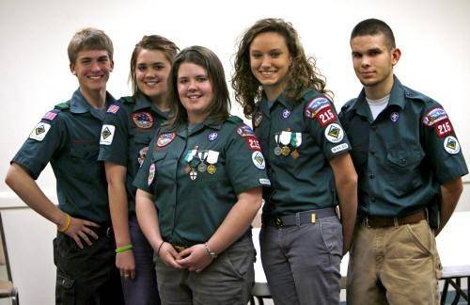
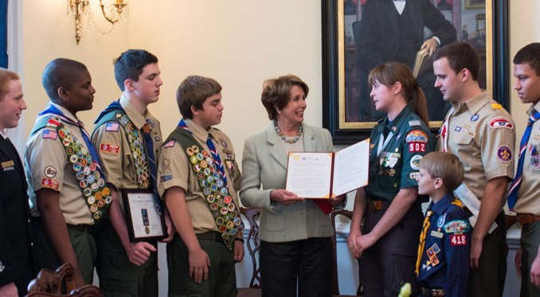
This is nothing new!
Girls and young women have been in the BSA since 1971!

Slide 3
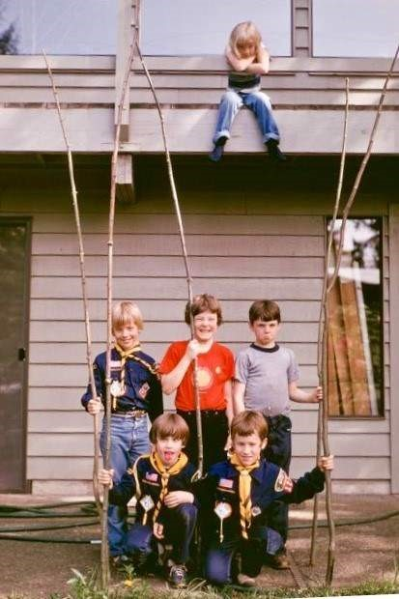
Cub Scout sisters
have been tagging
along since 1930…

Slide 4
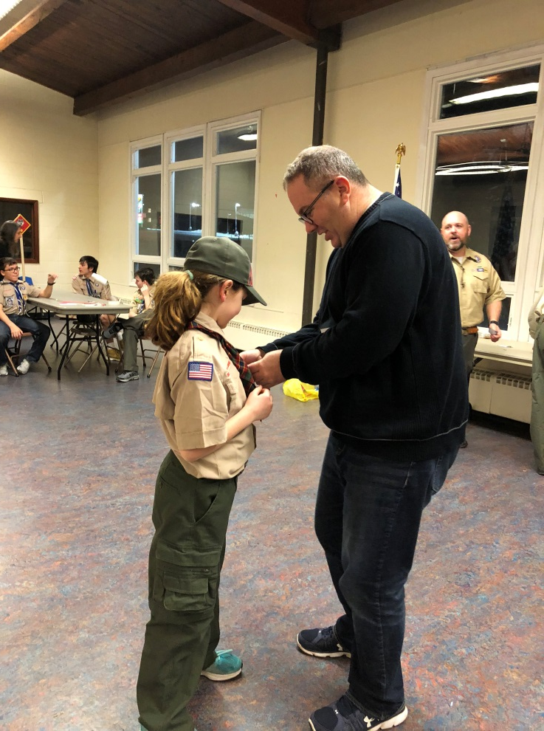
…and they have wondered why they can’t get the awards their brothers earn!

Slide 5
2017 Family Scouting
Receptivity Study

Slide 6
CUB SCOUT PROGRAM
Overall, families not currently involved in Scouting as well as current Scouting families indicate high interest in having their daughters in the Cub Scout program.
Parents of Daughters:
Parents are not currently involved in Scouting
Parents of Daughters:
Parents are currently involved in Scouting
How likely would you be to get your daughter(s) and son(s) age 5-10 involved
in the program as described above?
How interested would you be in the Cub Scout program for your daughter if offered by Boy Scouts of America?
Extremely
likely/interested
Very
likely/interested
90%
Likely
88%
Likely
68%
Interested
Somewhat
likely/interested
Likelihood of parents to get daughters involved in Cub Scouts
Likelihood of parents to get sons involved
in Cub Scouts
Interest in Cub Scout Program for daughter
2017 Family Scouting Receptivity Study | Research & Strategy

Slide 7
CUB SCOUT PROGRAM
Three-quarters of unit leaders, and those who have earned their Eagle Scout award, are extremely or somewhat interested in the Cub Scout program for their daughters.
How interested would you be in the Cub Scout program for your daughter if offered by Boy Scouts of America?
Extremely
interested
Somewhat
interested
76%
Interested
74%
Interested
NESA
n=1,088
Unit leaders (Cubmasters, Den leaders, Scoutmasters)
n=5,079
2017 Family Scouting Receptivity Study | Research & Strategy

Slide 8
SCOUT PROGRAM
Parents of girls aged 11-16, who do not currently have a child in the Boy Scout program, indicate a high likelihood of joining.
Girls aged 11 -16 also indicate a high likelihood of joining.
Parents:
Girls ages 11-16:
How likely would you be to get your son(s) and daughter(s) age 11-16 involved in the program as described above?
How likely would you be to get involved in the program as described above?
Extremely
likely
Very
likely
84%
Likely
87%
Likely
90%
Likely
Somewhat
likely
Parents of boys
n=129
Parents of girls
n=550
Girls
n=567
2017 Family Scouting Receptivity Study | Research & Strategy

Slide 9
SCOUT PROGRAM
Most Boy Scouts are in favor of expanding the program offerings to girls. Less than one-third of Boy Scouts who were negative about the change would consider no longer participating – that accounts for about 6 percent of the entire Boy Scout population.
Boy Scout Opinion about
Program Expansion
Impact on Boy Scouts’ Participation
(among those opposed to the addition)
Do you believe that this would be a positive
program addition to the Boy Scouts of America?
How would your negative view affect your future participation
in Scouting?
Definitely yes
It wouldn’t
22% not positive
x 28% would no longer participate =
6% potential boy loss
Probably yes
61%
Definitely yes,
or probably yes
I would be less
excited about Scouting
Maybe
I would no longer
want to participate
Probably no
Not sure
Definitely no
Boy Scouts opposed
to program expansion
n =229
Boy Scout Members
n=1,037
2017 Family Scouting Receptivity Study | Research & Strategy

Slide 10
Summary
  Families want access to BSA program offerings,
  in a way that fits into their busy lives, to deliver character development and values-based leadership training that Scouting promises.
  Comprehensive research conducted on this topic, shows there is high receptivity and interest in an expanded program for youth girls.
  The current curriculum for the Cub Scout and Boy Scout programs is deemed relevant for both boys and girls.

Slide 11
Why is BSA doing this?
How does it work?
What is PPC doing to help?

Slide 12
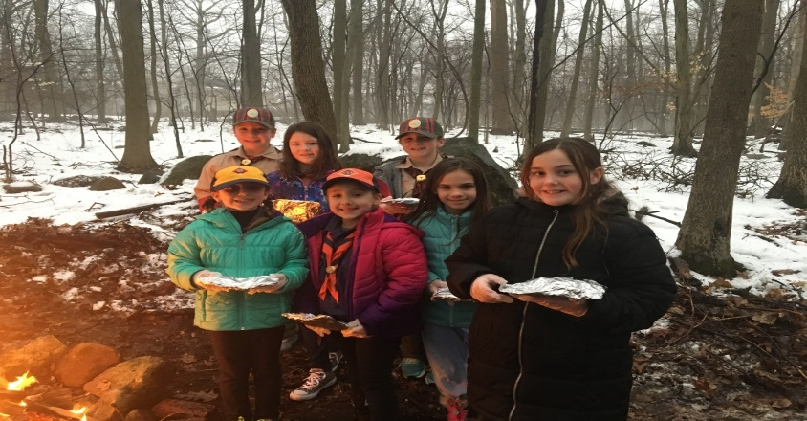
Family Scouting
BSA National Board Approved Family Scouting
October 11, 2017
Program Rollout:
Early Adopter Girls in Cub Scouts – January 15, 2018
Full Launch of Girls in Cub Scouts – June 1, 2018
Troop-Age Girls in Scouts – February 1, 2019

Slide 13
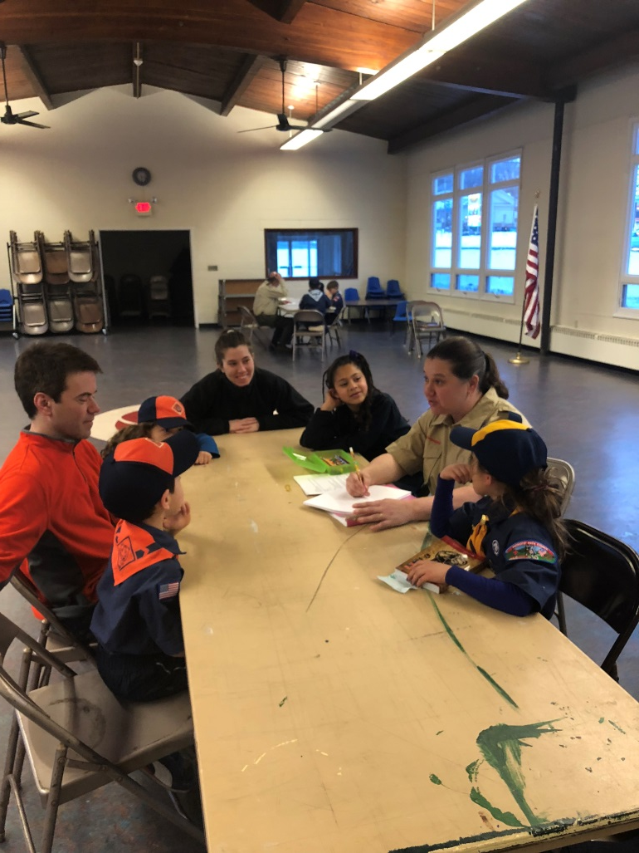
Family Scouting
Girls in Cub Scouts - 2018
Same Program, Awards, Activities, Ranks, Uniforms for all Cub Scouts
Dens: Single-gender only
Packs: Three choices
Remain all-boy Pack
Switch to Family Scouting with
  All-boy Dens, and
  All-girl Dens
Form new all-girl Pack

Slide 14
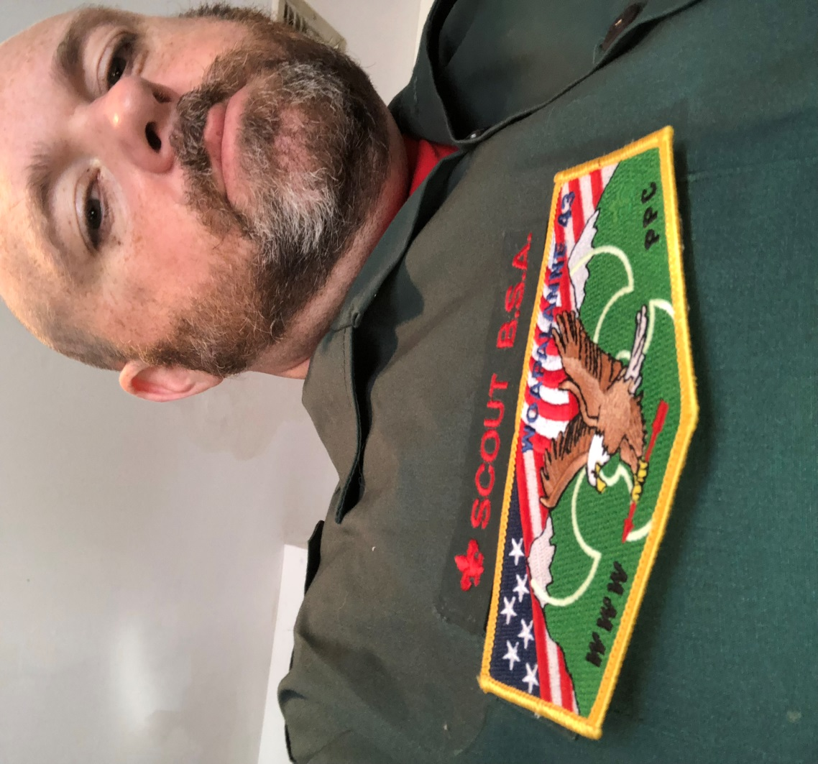
Family Scouting
Girl Troops – February 1, 2019
SCOUTS BSA
Same Program, Awards, Ranks, Activities
Including Eagle Scout
(Girl “Eagle Class” date TBD)
Single-Gender Troops Only
Not co-ed
No Girls in Current Troops Start New Troops

Slide 15
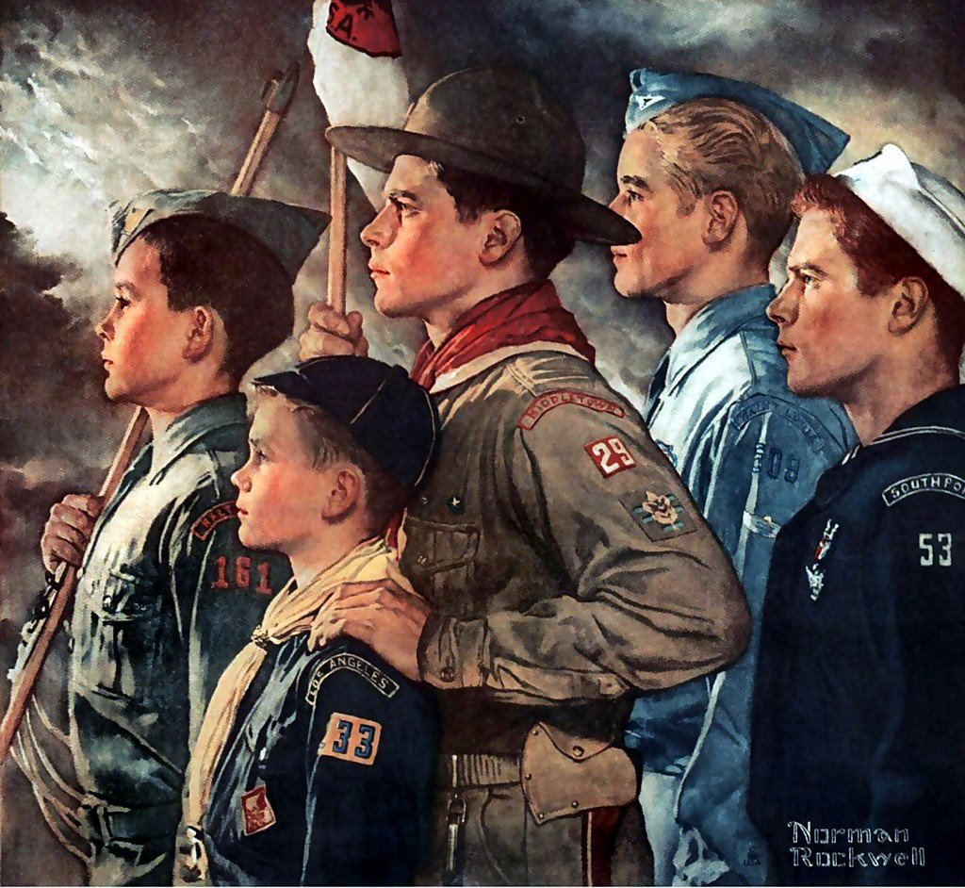
One Possibility - Linked Troops
Could have same:
Charter Organization
Unit Committee
Must have different:
Scoutmasters
Can coordinate some activities

Slide 16
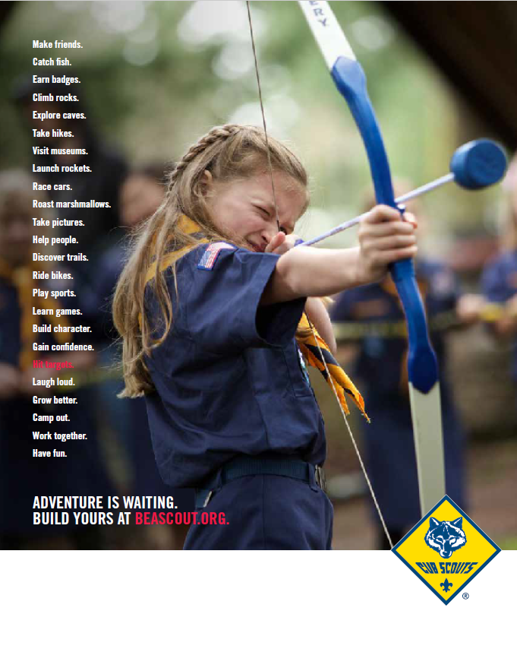
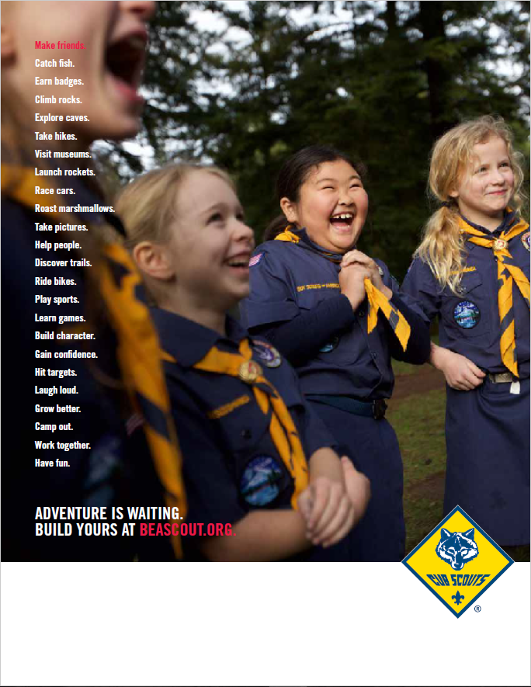
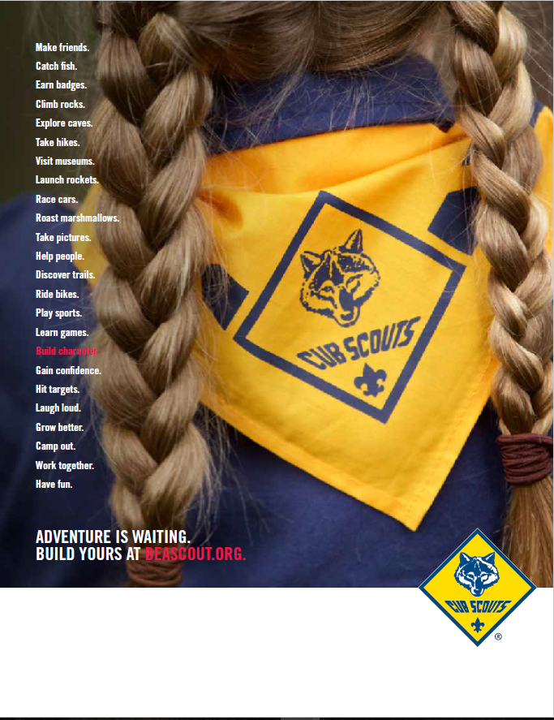
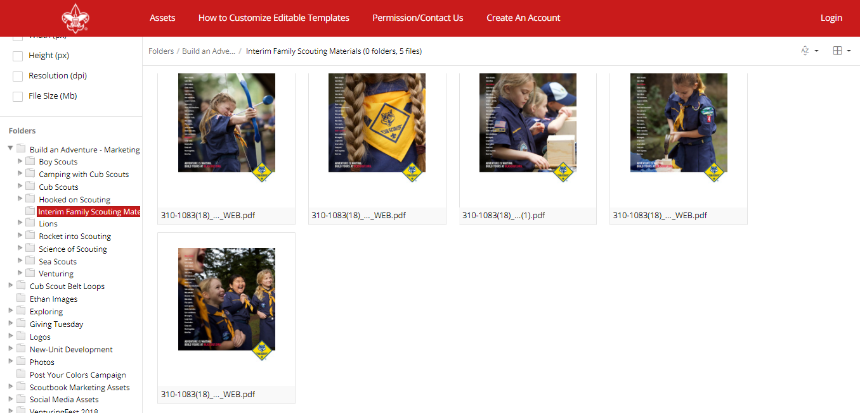
CUB SCOUT RECRUITING MATERIALS AVAILABLE
FROM NATIONAL BSA…OTHERS MATERIALS COMING
Notes:
For early adopter councils, there is now a selection of recruiting material available. It has been sent to early adopter councils and is on the BSA Brand Center.
This is just first round – and there is more to come.
To be clear – this is NOT the fall recruitment campaign. It’s interim for use by the early adopter units.

Slide 17
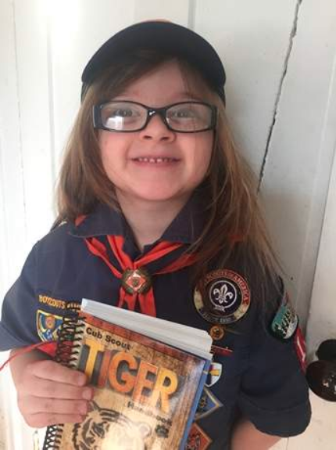
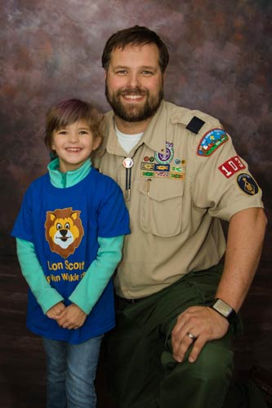

347 MILLION IMPRESSIONS
850+ MEDIA PLACEMENTS
CHICAGO
NEW YORK CITY
BOSTON
PORTLAND
ATLANTA
CHARLESTON
SACRAMENTO
MILWAUKEE
Notes:
In addition to the CBS Sunday Morning piece, BSA is continuing to spread the word with placements in major markets.
To date – we’ve had more than 250 million impressions through more than 850 placements.

Slide 18

BSA program launch will encompass a fully integrated strategy that spans paid, owned and earned channels. (May 2, 2018)

Slide 19
Why is BSA doing this?
How does it work?
What is PPC doing to help?

Slide 20
Patriots’ Path Council
Family Scouting Committee
(12/14/2017)
Committee Composition:
  Representatives of all 6 Districts = District Champions
  Representatives from all relevant PPC Committees
Committee Objectives:
  Insure full disclosure of the correct material as it comes from the National Office, through Patriots’ Path Council, to the leaders, chartered organizations, and the public (as necessary).
  Insure that all Council and District activities are properly marketed (timing, language, etc.), proper facilities are available, and staff are on hand.

Slide 21
Patriots’ Path Council
Family Scouting Committee
Facilitated “Early Adopter” Cub Scout options for interested packs and scouts
  “Program timelines” were created and provided to early adopter Den Leaders to help them complete their ranks for timely advancement.
  Provided training resources for leaders
  Early Adopter Applications were approved as appropriate (5 Packs). Pack 165 started girls 1/15 and was the first in NJ!

Slide 22
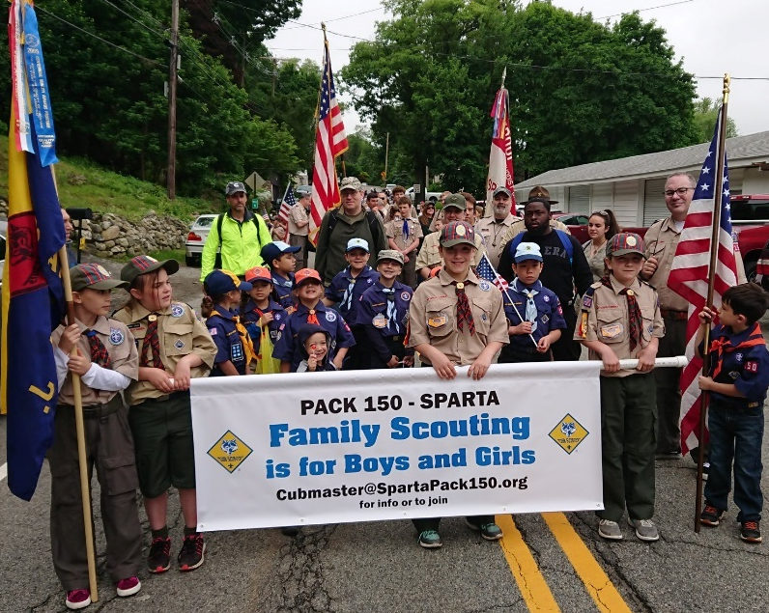
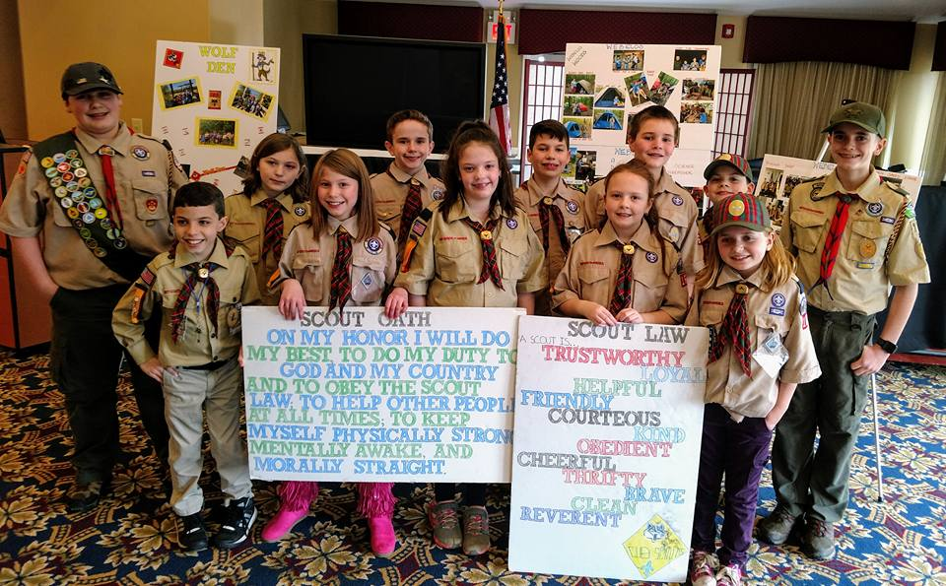
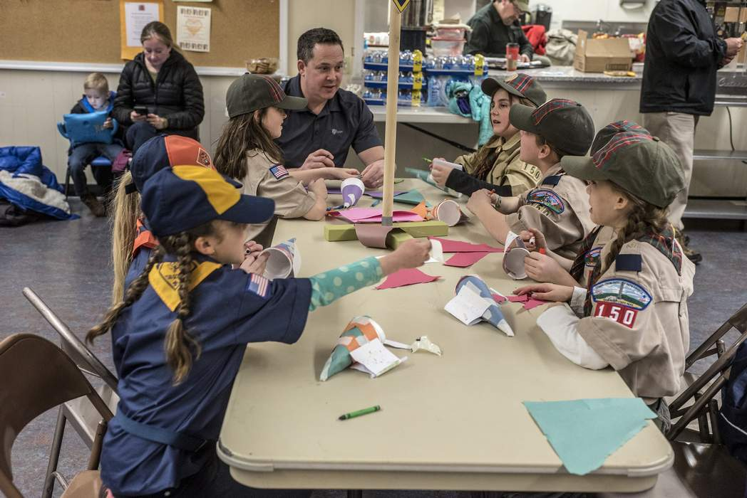
Patriots’ Path Council
Early Adopter Packs

Slide 23
Patriots’ Path Council
Family Scouting Committee
Communication is key!
  Family Scouting (358familyscouting@scouting.org) e-mail address has been established and publicized for questions and communications from PPC units, and others.
  Family Scouting web page has been set up, and is constantly updated as part of the Membership page of PPCBSA.org (https://ppcbsa.org/membership/familyscouting/)
  National BeAScout.org website is updated to indicate Family Packs as they declare themselves.
  Family Scouting Presentations were conducted at PPC Annual Meeting, all District Alumni Gatherings, President’s Council Meeting, District Roundtables.
  Tradeshow of Scouting, will include two presentations and have Family Scouting Tables on both the Tradeshow and Cub EXPO sides.

Slide 24
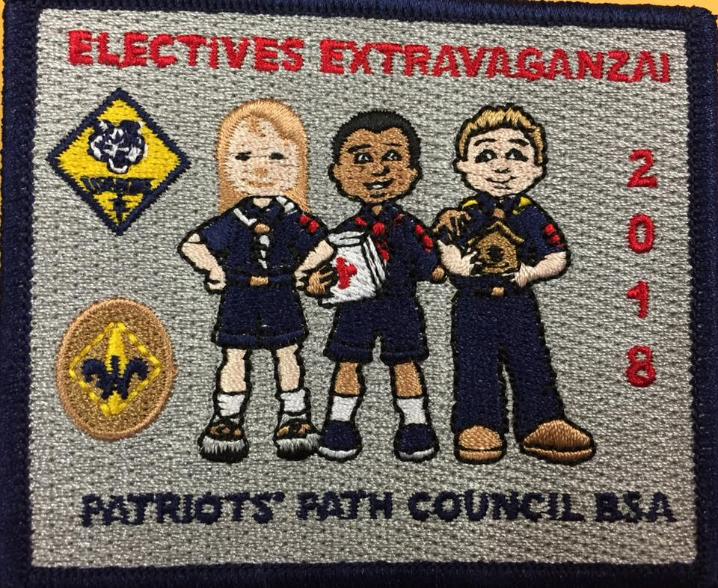
Patriots’ Path Council
Family Scouting Committee
3a. Council Committees are participating through their representatives.
  Advancement
    Electives Extravaganza was
    directly communicated to
    all Early Adopter Den Leaders,
    with availability assured to
    their girls.

Slide 25
Patriots’ Path Council
Family Scouting Committee
3b. Council Committees are participating through their representatives
  Camping
    Cub Scout Summer Program flyers were revised to be “gender-neutral.”
    Spring-recruited girls can attend camp as Cub Scouts, with girls in all-girl Dens, as they have in the past with Wildflowers.
  Training
      Training Workshops were held in January and February 2018 including Cub Scout Leader Position-Specific training, Timeline Training, and Youth Protection Training.

Slide 26
Patriots’ Path Council
Family Scouting Committee
3b. Council Committees are participating through their representatives
  Membership
      Cub Scout recruiting materials were revised to be “gender-neutral.”
      Membership Breakfast on 4/7/18 included Family Scouting
      Cub Scout Spring recruiting can include girls, who can start in new rank as soon as school is out.

Slide 27
Patriots’ Path Council
Family Scouting Committee
Full launch of Girl Cub Scout Program came on June 1, 2018 with Spring recruiting underway.
  Timeline was created for bringing additional girls into Cub Scouting for the full launch.
  Letter was distributed about Pack choices for 2018-19, along with “2018-2019 Cub Scout Pack Designation Form” for Packs to declare whether they will be all-boy, Family Packs, or need info on all-girl Packs.
  Commissioners and District Champions encouraged return of the Pack Designation forms.
  District Champions and Professional Staff are prepared for any all-girl Pack requests we might receive.

Slide 28
Patriots’ Path Council
Family Scouting Committee
Scouts BSA Troops for girls-only started on February 1, 2019.
  Timeline has been created for starting Girl Troops, so they could be up and running to receive AOL crossover Girls in February, 2019. These new Troops recruited girls from 11-17.
  Training for new girl youth leaders was offered in October 2018.
  District Champions to look at possible Chartering Organizations for new Girl Troops.

Slide 29

Mary Ruth Lareau, PPC VP Family Scouting
Email: Maryruthlareau@aol.com

