Slide 1
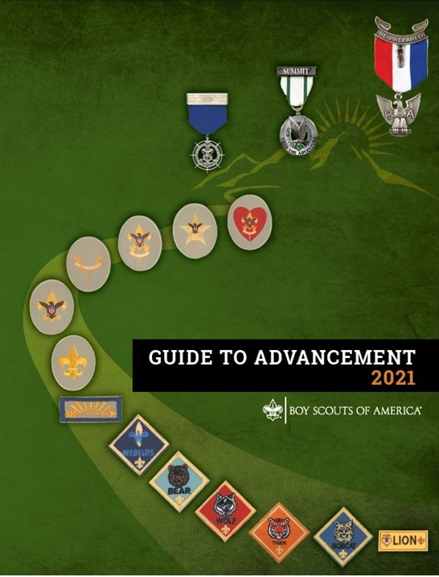
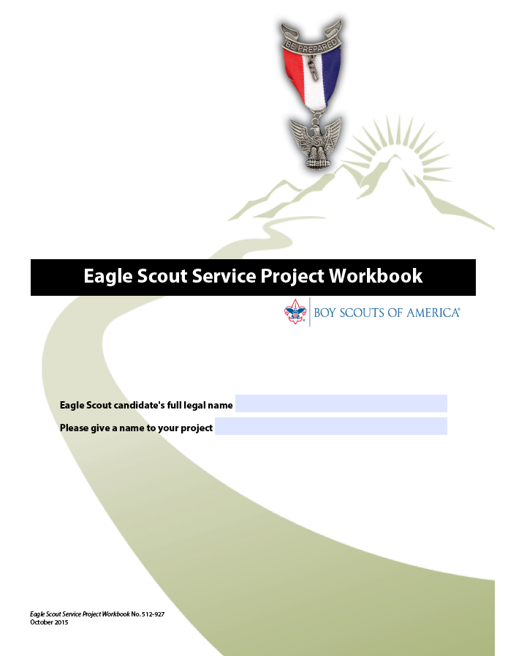
District Advisor
Eagle Project Approvals
Michael Merritt
PPC Advancement Committee
Member at Large
michael@mischu.me
973 568 7979
Bob Weber
Fishawack District Advancement Committee Chair
University of Scouting
December 4, 2021
Topics 9.0.2.0 through 9.0.2.15!

Slide 2
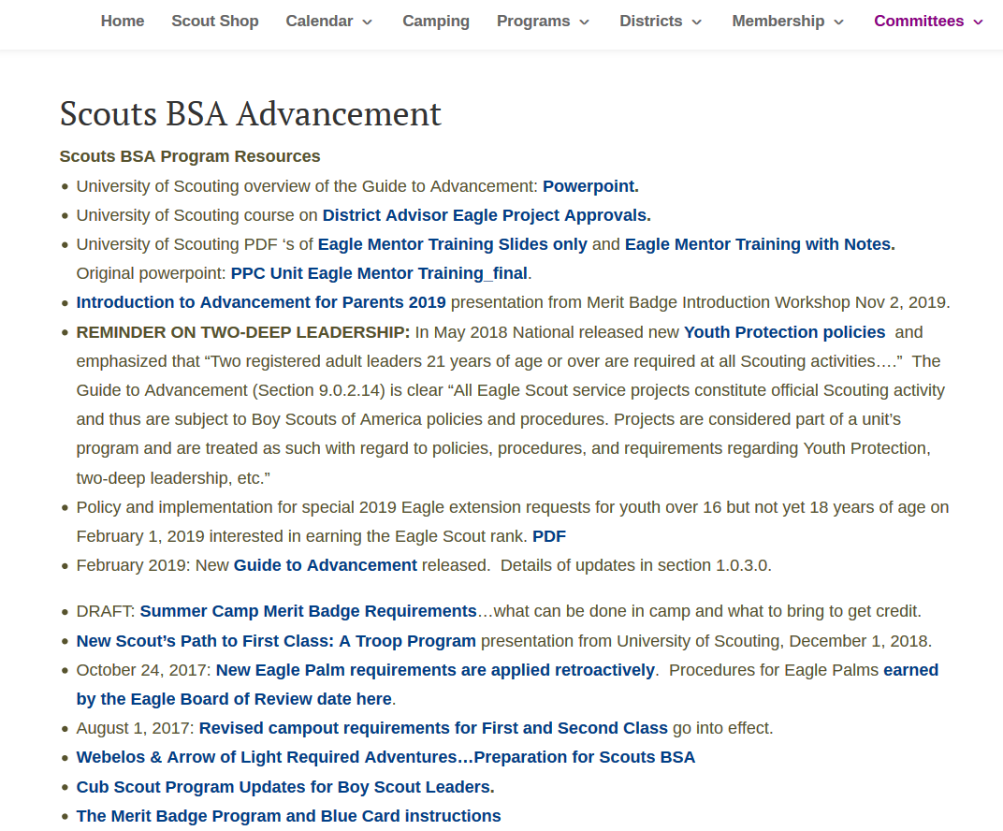

Slide 3
Council or District Approval
I have read topics 9.0.2.0 through 9.0.2.15, regarding the Eagle Scout
service project, in the Guide to Advancement, No. 33088. I agree on
my honor to apply the procedures as written, and in compliance with
the policy on “Unauthorized Changes to Advancement.” Accordingly,
I approve this proposal. I will encourage the candidate to prepare a
project plan and share it with the designated project coach .
Signed
Name (Printed) Date
Notes:
This is the signature box for District Advancement Advisors in the Eagle . It can be helpful to review the other three approvals.

Slide 4
Unit Leader Approval*
I have reviewed this proposal and discussed it with the candidate. I
believe it provides impact worthy of an Eagle Scout service project,
and will involve planning, development, and leadership. I am
comfortable the Scout understands what to do, and how to lead the
effort. I will see that the project is monitored, and that adults or
others present will not overshadow him.
Signed
Name (Printed) Date

Slide 5
Unit Committee Approval*
This Eagle Scout candidate is a Life Scout, and registered in our unit. I
have reviewed this proposal, I am comfortable the project is feasible,
and I will do everything I can to see that our unit measures up to the
level of support we have agreed to provide (if any). I certify that I
have been authorized by our unit committee to provide its approval
for this proposal.
Signed
Name (Printed) Date

Slide 6
Beneficiary Approval*
This service project will provide significant benefit, and we will do all
we can to see it through. We realize funding on our part is not
required, but we have informed the Scout of the financial support (if
any) that we have agreed to. We understand any fund raising he
conducts will be in our name and that funds left over will come to us
if we are allowed to accept them. We will provide receipts to donors
as required.
Our Eagle candidate has provided us a copy of “Navigating the
Eagle Scout Service Project, Information for Project Beneficiaries.”
Yes No
Signed Date
Name (Printed)

Slide 7
Council or District Approval
I have read topics 9.0.2.0 through 9.0.2.15, regarding the Eagle Scout
service project, in the Guide to Advancement, No. 33088. I agree on
my honor to apply the procedures as written, and in compliance with
the policy on “Unauthorized Changes to Advancement.” Accordingly,
I approve this proposal. I will encourage the candidate to prepare a
project plan and share it with the designated project coach .
Signed
Name (Printed) Date

Slide 8
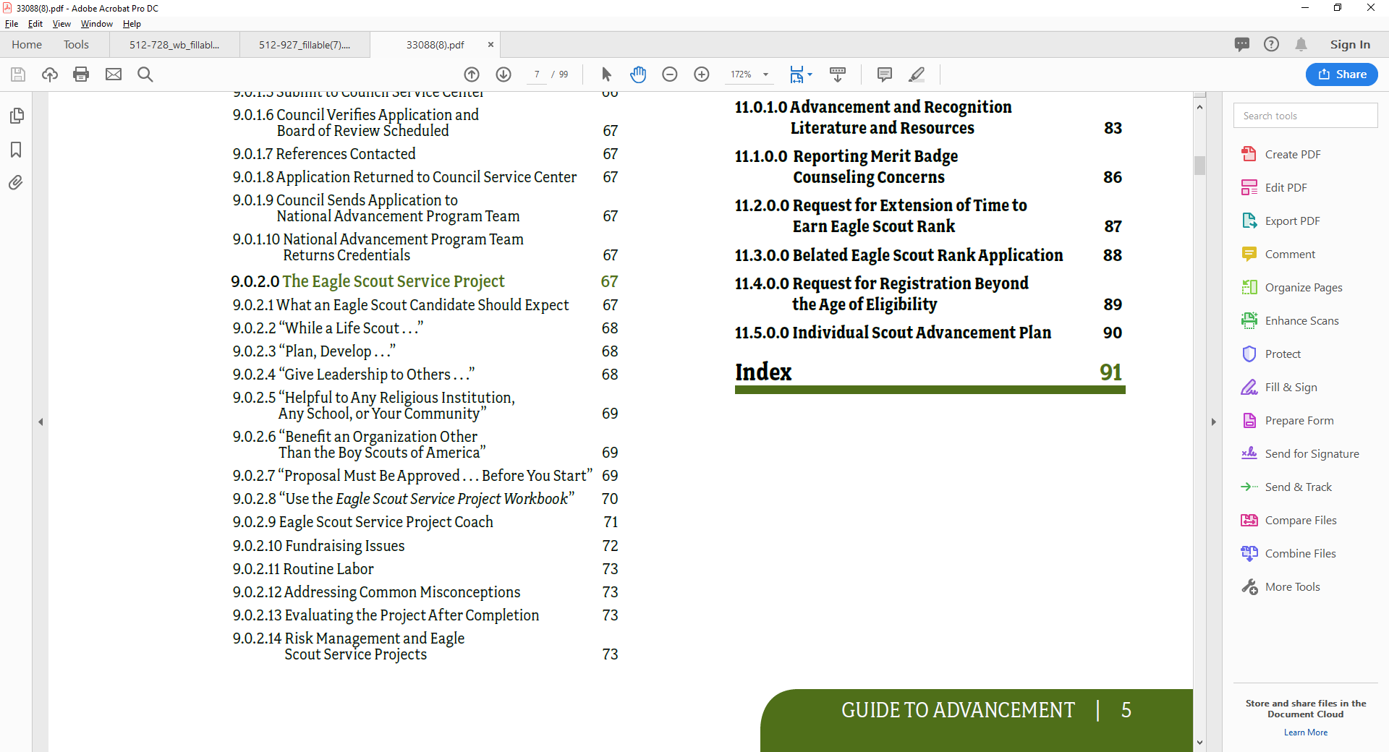
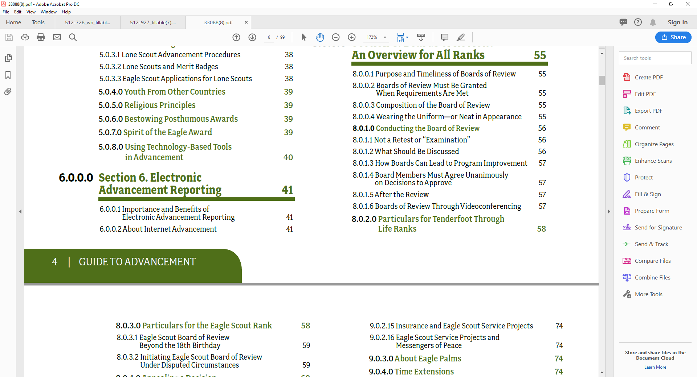
“I have read topics 9.0.2.0 through 9.0.2.15, regarding the Eagle Scout service project, in the Guide to Advancement, No. 33088.”
Notes:
This is the table of contents from the Guide to Advancement. We’re talking about reading…understanding…and implementing eight pages.

Slide 9
9.0.2.0 The Eagle Scout Service Project
While a Life Scout, plan, develop, and give leadership
to others in a service project helpful to any religious
institution, any school, or your community.
Notes:
(The project must benefit an organization other than the Boy Scouts of
America.) A project proposal must be approved by the organization benefiting from the effort, your unit leader and unit committee, and the council or district before you start. You must use the Eagle Scout Service Project Workbook, BSA publication No. 512-927, in meeting this requirement.—Eagle Scout requirement 5

Slide 10
9.0.2.1
What an Eagle Scout Candidate Should Expect
especially during the proposal approval process,
a candidate has the right to expect the following:
  1. Questioning and probing for his understanding of the
  project, the proposal, and what must be done, shall
  be conducted in a helpful, friendly, courteous, and
  kind-hearted manner. We will respect the Scout’s
  dignity.
  2. Project expectations will match Eagle Scout
  requirement 5, and we will not require proposals
  to include more than described in the Eagle Scout
  Service Project Workbook.
Notes:
He will be allowed, if he chooses, to have a parent, unit leader, or other adult present as an observer at any time he is discussing his proposal or project with someone who is reviewing it.

Slide 11
9.0.2.1
What an Eagle Scout Candidate Should Expect
3. If requested by the Scout or his parent or guardian,
an explanation of a proposal rejection will be
provided in writing, with a copy sent to the council
advancement chair and staff advisor. It will indicate
reasons for rejection and suggestions concerning
what can be done to achieve approval.
4. Guidance that maximizes the opportunity for
completion of a worthwhile project will be readily
available and strongly recommended. Ultimately,
however, the responsibility for success belongs to the
Scout, and final evaluation is left to the board of review.

Slide 12
9.0.2.1
What an Eagle Scout Candidate Should Expect
5. If the candidate believes he has been mistreated
or his proposal wrongfully rejected, he will be
provided a method of redress. This will include
the opportunity for a second opinion and approval,
either through another volunteer or professional
advancement administrator, or the Scout executive,
as determined by the council advancement
committee or executive board.

Slide 13
9.0.2.3 “Plan, Develop …”
9.0.2.2 “While a Life Scout …”
Work on a project, including planning, begins after
the Life Scout board of review. But this is not meant to
preclude an enthusiastic Star Scout from talking with his
Scoutmaster, religious leader, or principal about what a
good project might be.
Planning and development require forethought, effort,
and time—sometimes more than for execution. Thus,
for the most part, they are considered part of the project
and are detailed further once a proposal is approved.
It is inappropriate to expect a Scout to invest the time
required for detailed planning, only to face the prospect
of rejection.
Notes:
See “Proposal Must Be Approved … Before You Start,” 9.0.2.7.
It is important not to categorically reject projects that, on the surface, may not seem to require enough planning and development. Consider, for example, a blood drive. Often rejected out of hand, this project, if done properly, could be acceptable. Few would question the beneficiary. Blood banks save lives—thousands of them: maybe yours, maybe that of a loved one. If the candidate proposes to use a set of “canned” instructions from the bank, implemented with no further planning, the planning effort would not meet the test.
On the other hand, there are councils in which Scouts and advancement committees have met with blood bank officials and worked out approaches that can comply. Typically these involve developing marketing plans and considering logistics. People successful in business know how important these skills are. Some blood banks will also set a minimum for blood collected as a measure of a successful plan. To provide another valuable lesson, they may require the candidate to keep at it until he’s met this goal.
A good test of any project is to evaluate its complexity. In the case of a blood drive, for example, elements of challenge and complexity can be added so there is a clear demonstration of planning, development, and leadership.

Slide 14
9.0.2.4 “Give Leadership to Others …”
“Others” means at least two people besides the Scout.
Leadership…could be considered a more important element, perhaps,
for Scouts who have not yet established themselves as leaders.
…every project must be evaluated, case-by-case, on its merits, and
on lessons that will advance the candidate’s growth.
Councils, districts, and units shall not establish requirements for the number
of people led, or their makeup, or for time worked on a project.
Nor shall they expect Scouts from different backgrounds, with different experiences and different needs, all to work toward a particular standard.
The Eagle Scout service project is an individualized experience.
Notes:
Helpers may be involved in Scouting or not, and of any age appropriate for the work. In cases where just three people are not able to conduct a project to the satisfaction of a beneficiary, then more would be advisable. It may be, however, that a well-chosen project conducted by only three provides an impact not achievable with those involving more.
One of the purposes for the project is to demonstrate leadership, but this could be considered a more important element, perhaps, for a Scout who has not yet had leadership experience. It is for reasons like these that every project must be evaluated, case-by-case, on its merits, and on lessons that will advance the candidate’s growth. Councils, districts, and units shall not establish requirements for the number of people led, or their makeup, or for time worked on a project. Nor shall they expect Scouts from different backgrounds, with different experiences and different needs, all to work toward a particular standard. The Eagle Scout service project is an individualized experience.

Slide 15
9.0.2.5 “Helpful to Any Religious Institution,
Any School, or Your Community”
“Any religious institution” and “any school” are self explanatory.
But what does “your community” mean?
9.0.2.6 “Benefit an Organization Other
Than the Boy Scouts of America”
“To help other people at all times” is a basic tenet. The Eagle Scout service project is an important and meaningful opportunity to practice what we teach.
Notes:
In today’s world of instant communications and speedy travel, we are affected more and more by what goes on all over the world. Prices for goods and services, investment values, our very safety, and how we feel about those less fortunate in other countries, all are involved. Thus, if a Scout wants to take his oath “to help other people” more expansively and put his project to work for the “community of the world,” he is allowed to do so. A council may emphasize more local efforts but should not deny worthy projects of a wider scope. Normally “your community” would not refer to individuals, although a council or district advancement committee may consider scenarios where an individual in need can affect a community. An example might involve elderly persons able to live at home but unable to maintain their property, with the result being an “attractive nuisance” or related dangerous situations, or even an eyesore— something that raises concern to more than that of just an individual. If it can be determined the community benefits, then it is a matter of identifying who will provide approvals. They must come from a source representing the “community,” such as a neighborhood association, watch group, homeowners association, or perhaps a division of a town or county. The project beneficiary need not be a registered nonprofit. Projects may not be of a commercial nature or for a business, but this is not meant to disallow community institutions that would otherwise be acceptable to the council or district advancement committee. These might include museums and various service agencies, or some homes for the elderly, for example. Some aspect of a business’s operation provided as a community service may also be considered; for example, a park open to the public that happens to be owned by a business. In cases such as these, the test is whether the project primarily benefits the community, as opposed to the profits of the business.
Projects must not be performed for the Boy Scouts of America or its councils, districts, units, camps, and so forth. The unit’s chartered organization, however, is certainly a good candidate, as are other youth organizations such as the Boys and Girls Clubs of America, the Girl Scouts of the USA, or other international Scouting organizations.

Slide 16
9.0.2.7 “Proposal Must Be Approved …
Before You Start”
The Five Tests of an Acceptable Eagle Scout Service
Project. The proposal is an overview, but also the beginnings of planning. It shows the unit leader and any representatives of a unit committee, council, or district, that the following tests can be met.
1. The project provides sufficient opportunity to meet the requirement.
2. The project appears to be feasible.
3. Safety issues will be addressed.
4. Action steps for further detailed planning are included.
5. The Scout is on the right track with a reasonable chance for a positive experience.
Notes:
The detail required for a proposal depends on project complexity. It must be enough to provide a level of confidence for a council or district reviewer that the above tests can be met, but not so much that—based on the possibility a proposal can be rejected—it does not respect the time it takes to prepare. The form for preparing a proposal appears in the Eagle Scout Service Project Workbook, No. 512-927. Completing it will represent a reasonable time investment and an introductory learning experience, and also provide the information needed for approval. The candidate shall not be required to submit more than is described there, or more than is necessary to establish that a project can meet the above tests. Space is provided in the workbook for the candidate to record comments made during discussions with the district or council volunteer going over the proposal. A thorough review should generate numerous suggestions, cautions, and perhaps concerns (see “What an Eagle Scout Candidate Should Expect,” 9.0.2.1). The Scout should be encouraged to write these down and take them seriously. When the reviewer is satisfied the five tests above can be met, then approval is granted. It is important to be as considerate of an Eagle Scout candidate’s time as we expect him or her to be of ours. The candidate is probably just as busy. Every attempt should be made to complete the approval process in one meeting. Then he should be challenged to work on his planning action steps and to consider scheduling time with his Eagle Scout service project coach for progress reports and further guidance (see “Eagle Scout Service Project Coach,” 9.0.2.9). It is advisable that one of these meetings with the coach be held after the Scout has done his planning and is ready to begin actual work on his project. It is acceptable for the coach or the advancement administrator responsible for approval—if he or she becomes concerned the project will not meet the requirements or it will not be completed to the satisfaction of the benefiting organization—to contact the Scout and his parent or guardian, or unit leader and, as appropriate, a representative of the beneficiary. However, even though the project coach may provide guidance critical to success, final design issues are ultimately between the Scout and the beneficiary. For limitations on the coach’s role, see “Eagle Scout Service Project Coach,” 9.0.2.9. From time to time Scouts will “jump the gun” and begin fundraising efforts—or even work on the project itself— before a proposal is approved. This is counter to the requirements and well covered in multiple documents, but still it happens. Normally then, a Scout should select a different project. If circumstances are compelling, however—indicating leniency can be extended and a lesson learned without significant detriment to fulfilling the project’s purpose—the Scout may be allowed to carry on and have his proposal or project approved after the fact. Because it is virtually impossible to forecast every contingency, candidates must be allowed a level of flexibility in carrying out proposals and planning action steps. But essential elements of a proposal should not be changed without good reason. If this must occur, the Scout should consult his project coach or unit leader for advice. It is appropriate to strongly suggest he or she share substantive changes with the project beneficiary, and also with those involved in preapprovals. If it appears changes will cause results to fall below what is required, then cautionary advice is in order. Except under extreme circumstances, it is not acceptable for unit, or council or district, approval to be withdrawn. If the young man decides to strike out on his own, this is his prerogative. At some point, responsibility must take over. The board of review decides whether planning was sufficient and if the requirement was met.

Slide 17
9.0.2.8 “Use the Eagle Scout Service
Project Workbook”
Using the workbook, No. 512-927, helps candidates avoid pitfalls. If properly used, it very nearly assures success.
The workbook should not, however, become a basis for rejecting candidates based on “technicalities” that have nothing to do with requirement intent.
In most cases Scouts should fully complete the proposal and project report, and be strongly encouraged to complete the project plan.
If it will be a hardship, or a poor use of time to fill in missing information or obtain a signature of a party who is unavailable or by some other means known to have approved it, then it is appropriate to accept it.
Notes:
Using the workbook, No. 512-927, helps candidates avoid pitfalls. If properly used, it very nearly assures success. It shows approvals have been secured, lists important limitations, suggests questions for those approving the project, and includes outlines for the proposal and the more detailed project plan that should come next. The workbook should not, however, become a basis for rejecting candidates based on “technicalities” that have nothing to do with requirement intent. While the use of the workbook is required, this does not mean that every line or even every form must be completed. In most cases Scouts should fully complete the proposal and project report, and be strongly encouraged to complete the project plan. However, at times it may not be feasible or just not necessary for establishing that the requirement was met. If it is clear the project was completed and approved of, and meets Eagle Scout requirement 5 as it is written, then the project should be considered. If it will be a hardship, or a poor use of time to fill in missing information or obtain a signature of a party who is unavailable or by some other means known to have approved it, then it is appropriate to accept it. There is something to be said for “object lessons,” but keep in mind that write-ups and signatures, though important, are simply supportive. Note that project report signatures need not be dated before the Scout’s 18th birthday. It is a project that we require. Boards of review should use common sense: Did the project meet the requirements or not? Was there planning and development? Was there leadership of others?

Slide 18
9.0.2.9 Eagle Scout Service Project Coach
• Meet with a Scout after the proposal has been approved but before work begins on the project plan.
• Ask the Scout to describe how the project will be planned, then offer advice accordingly.
• Emphasize those elements of a plan that, if ignored, could stop work or create health and safety issues.
• Remind the Scout to share the plan with the project beneficiary; the beneficiary should be fully aware of what will be done. Note that plans for an Eagle Scout service project are between the Scout and the
beneficiary. Coaches do not approve project plans.
• Be available to the Scout as a consultant should there be questions about the planning process.
• Meet with the Scout to review the project plan; discuss its strengths, weaknesses, and risks; and suggest critical improvements.
Notes:
The Eagle Scout service project coach is the subject matter expert on the processes and standards of the service project. He or she is the key to success in council or district efforts to provide guidance as Scouts work to fulfill requirement 5. The following are important examples of ways in which the coach can influence a Scout’s project: • Meet with a Scout after his proposal has been approved but before work begins on the project plan. • Ask the Scout to describe how the project will be planned, then offer advice accordingly. • Emphasize those elements of a plan that, if ignored, could stop work or create health and safety issues. • Remind the Scout to share his plan with the project beneficiary; the beneficiary should be fully aware of what will be done. Note that plans for an Eagle Scout service project are between the Scout and the beneficiary. Coaches do not approve project plans. • Be available to the Scout as a consultant should there be questions about the planning process. • Meet with the Scout to review the project plan; discuss its strengths, weaknesses, and risks; and suggest critical improvements. Discuss the project report with the Scout and offer advice on how to make a strong presentation at the board of review. Remember that any contact with the Scout must be conducted according to Youth Protection procedures. Experience has taught us the most effective approach to providing coaches is for the council or district to organize a pool of volunteers willing to serve in that capacity, and then designate them to individual Eagle Scout candidates. Many units have used service project “mentors” or “advisors” through the decades since the Eagle Scout service project came to be. This practice has provided consistent positive contributions and should continue. Their efforts, however, should serve to provide ongoing support throughout project planning and execution and to prepare a Scout to work with the council or district designated project coach. The role of the designated project coach is not intended to require so close an association with a Scout that it becomes impossible for a council or district to recruit enough of them to work with candidates whose proposals have been approved. The more ongoing and close association should come from unit volunteers or parents assisting in support roles. It is recognized, however, that some councils or districts may not have the volunteer capacity to provide designated coaches. For this reason, the council advancement committee may decide to designate the project coach from among unit volunteers. But they should do so with the understanding that a coach who is designated within a unit should represent the perspective of the council or district. Regardless the source of project coaches, they must adhere to the Eagle Scout service project process as described in this section of the Guide to Advancement. Coaches do not have approval authority. Instead they serve to encourage—not direct—the young men to make the kinds of decisions that will lead to successful outcomes. It is true a Scout need not accept the assistance of the service project coach. Regardless, it is considered best for the council or district to designate one for every Scout who submits a project proposal for approval. The coach should then contact the Scout and suggest a first meeting, or telephone or video conference. Scouts have already promised when they submit a proposal that they have read the service project workbook, and thus they should already understand a coach is optional. If a young person suggest a coach isn’t needed, they should be counseled on the value a coach can add. Ultimately, however, working with a designated Eagle Scout service project coach is the Scout’s decision. It is important to note that Eagle service project coaches do not have the authority to dictate changes; withdraw approval that was previously granted, such as by the council or district; or take any other such directive action. Instead, coaches must use the BSA method of positive adult association, logic, and common sense to help the candidate make wise decisions. In many cases, candidates will not have undertaken something like an Eagle service project. Thus, we want them to obtain guidance from others, share ideas, seek plan reviews, and go through other processes professional project planners might use. But like a professional, the Scout makes the decisions. The candidate must not simply follow others’ directions to the point where his or her own input becomes insignificant. On the other hand, adult leaders must bear in mind the candidate is yet a youth. Expectations must be reasonable and fitting.

Slide 19
9.0.2.10 Fundraising Issues
Projects may not be fundraisers. In other words, the candidate may not stage an effort that primarily collects money, even if it is for a worthy charity.
Fundraising is permitted only for securing materials and otherwise facilitating a project.
And unless it involves contributions only from the beneficiary; or from the candidate, his parents, guardians, or relatives, his unit or its chartered organization; or from parents or members in his unit, it must be approved by the local council. (In PPC, p to $2500 Unit Committee, up to $10,000 District Advancement, above $10,000 Council Finance.)
Fundraising for an Eagle Scout service project shall not be required of any candidate.
The Eagle Scout Service Project Fundraising Application must not be required to accompany the project proposal. At that point in the process, the
Scout may not have enough information to complete the application.
Notes:
Projects may not be fundraisers. In other words, the candidate may not stage an effort that primarily collects money, even if it is for a worthy charity. Fundraising is permitted only for securing materials and otherwise facilitating a project. And unless it involves contributions only from the beneficiary; or from the candidate, his parents, guardians, or relatives, his unit or its chartered organization; or from parents or members in his unit, it must be approved by the local council. Fundraising for an Eagle Scout service project shall not be required of any candidate. Whether or not fundraising takes place is the Scout’s decision based on the needs of his project. The BSA prefers, in fact, that Scouts choose projects that can be done at little or no cost. Fundraising—especially on a larger scale—has tax, accounting, and other legal implications, in which minors should not be involved. Thus, if fundraising is to take place, it is best that it be kept simple. Typical unit fundraisers with which unit leadership is familiar, such as car washes, are the best options. Another alternative, contingent on local council approval, is the use of “crowdfunding” via the internet. If this method is used, however, then all concerned, from the Scout and his parent or guardian to the unit leader and those approving fundraising at the local council, should be aware that fees may be involved and that fundraising for something like an Eagle project may or may not comply with the website’s terms of service. There can be other issues as well, such as what to do if more—or less—than what is needed is raised. It is important that someone in a position of responsibility reads and understands the website’s “fine print.” If fundraising takes place, Eagle candidates must also be allowed the choice not to be involved in it. If Scouts do give leadership to fundraising efforts, then this can be considered in fulfilling that part of requirement 5 to “give leadership to others.” If Scouts are not involved, or if all of the contributions come from relatives, for example, the Scout shall not be penalized. His leadership in the project itself should be the primary basis for determining whether requirement 5 has been met. The Scout must make it clear to all donors or event participants that the money is being raised on behalf of the project beneficiary, which will retain leftover funds. Should any donors want documentation of a gift, this must be provided through the project beneficiary, not the Boy Scouts of America. Once collected, money raised must be turned over to the beneficiary or the candidate’s unit until needed for the project. If the unit receives the funds, it must release any excess to the beneficiary once expenses have been paid. If the beneficiary is not allowed, for whatever reason, to retain any excess funds, supplies, or materials, the beneficiary should be asked to designate a suitable charity to receive them or allow the unit to retain the funds. The unit must not influence this decision. For additional detail see “Procedures and Limitations on Eagle Scout Service Project Fundraising,” found in the Eagle Scout Service Project Workbook, No. 512-927, on the reverse of the Eagle Scout Service Project Fundraising Application. The Eagle Scout Service Project Fundraising Application, found in the Eagle Scout Service Project Workbook, is used to obtain approval when required. Note that local councils may add further definition to the standards established here or on the application form. For example, they could state that fundraisers such as bake sales and car washes do not require a fundraising application and are, in essence, preapproved. They could also establish dollar thresholds; for example, “Any effort expected to raise less than $500 does not require an application.” Completed forms are sent to the local council service center where they are routed to those responsible for approval. This may be a district executive or another staff member, the council or district advancement committee, a finance committee, etc., as determined appropriate by the local council.

Slide 20
9.0.2.11 Routine Labor
Routine labor is not normally considered appropriate for a project.
This might be defined as a job or service that a Scout may provide as part of his daily life, or a routine maintenance job normally done by the beneficiary
(for example, picking the weeds on the football field at a school).
But the real test has to do with scale and impact.
If “routine labor” is conducted on so large a scale it requires planning, development, and leadership, it may have sufficient impact.

Slide 21
9.0.2.12 Addressing Common Misconceptions
1. No unit, district, council, or individual shall place any requirement or other standard on the number of hours spent on a project. The Boy Scouts of America collects data about time worked on Eagle Scout service projects only because it points to a level of excellence in achieving the BSA aim related to citizenship.
2. Eagle Scout service projects are individual matters. No more than one candidate may receive credit for working on the same project.
3. There is no requirement a project must have lasting value.
4. Any plans completed after the project proposal has been approved by the council or district are between the Scout and the beneficiary. The role of beneficiaries in reviewing plans is explained in the service project beneficiary information sheet, “Navigating the Eagle Scout Service Project,” that is posted on the Advancement Resources page at www.scouting.org/advancement, and is included in the Eagle Scout Service Project Workbook.

Slide 22
9.0.2.13 Evaluating the Project After Completion
Eagle Scout service projects must be evaluated primarily
on IMPACT—the extent of benefit to the religious institution, school, or community,
and on the LEADERSHIP provided by the candidate.
There must also be evidence of PLANNING and DEVELOPMENT.
…reviewers must not require more planning and development than necessary to execute the project.
Notes:
Eagle Scout service projects must be evaluated primarily on impact—the extent of benefit to the religious institution, school, or community, and on the leadership provided by the candidate. There must also be evidence of planning and development. This is not only part of the requirement, but relates to practicing our motto to “Be Prepared.” However, in determining if a project meets requirement 5, reviewers must not require more planning and development than necessary to execute the project. These elements must not overshadow the project itself, as long as the effort was well led, and resulted in an otherwise worthy outcome acceptable to the beneficiary. There may be instances where, upon its completion, the unit leader or project beneficiary chooses not to approve a project. One or the other may determine, for example, that modifications were so significant that the extent of service or the impact of the project were insufficient to warrant approval. The candidate may be requested to do more work or even start over with another project. The candidate may choose to meet these requests or may decide—if believing the completed project is worthy and in compliance—to complete the Eagle Scout Rank Application and submit the project workbook without final approval. The candidate must be granted a board of review, should it be requested. If it is thought a unit board may not provide a fair hearing, a board of review under disputed circumstances may be initiated. (See “Initiating Eagle Scout Board of Review Under Disputed Circumstances,” 8.0.3.2.) The risk in this approach—that the board may decide negatively—should be discussed with the Scout. But at the same time, the fact he or she is so convinced may point to a need to reevaluate what was done. Perhaps, despite the lack of final approval, the project did indeed meet the requirement. From time to time, beneficiaries unfamiliar with the Eagle Scout service project process may decline to approve a completed project even though it was helpful and had a positive impact. For example, there have been situations in which beneficiaries sought to require last-minute additions before signing off, and others where new management had different ideas about what should have been done. In these cases it is appropriate for the Scout to move forward without the final approval, and for the board of review to understand that the requirement has been met, regardless. At the board of review, if an approved proposal and any subsequent effort represents planning and development that was adequate to the project, and the project was well led and carried out to the satisfaction of the unit leader and project beneficiary, only in a very rare case would rejection result. It would have to be clearly established that Eagle Scout requirement 5—as written— was not completed. Under no circumstances shall project approval at any point in the process be withheld for reasons that have nothing to do with the project.

Slide 23
9.0.2.14 Risk Management and Eagle Scout
Service Projects
Projects are considered part of a unit’s program and are treated as such with regard to policies, procedures, and requirements regarding Youth Protection, two-deep leadership, etc.
The unit leader or unit committee should reject proposals for inherently unsafe projects.
The candidate should plan for safe execution, but it must be understood that minors cannot and must not be held responsible for safety concerns.
the Guide to Safe Scouting applies. The “Sweet 16 of BSA Safety” must also be consulted as an appropriate planning tool.
Notes:
All Eagle Scout service projects constitute official Scouting activity and thus are subject to Boy Scouts of America policies and procedures. Projects are considered part of a unit’s program and are treated as such with regard to policies, procedures, and requirements regarding Youth Protection, two-deep leadership, etc. Unit leadership should be aware of project plans and schedules. The health and safety of those working on Eagle projects must be integrated into project execution. Since an Eagle Scout service project is a unit activity, unit adult leadership has the same responsibility to assure safety in conducting a project as with any other unit activity. The unit leader or unit committee should reject proposals for inherently unsafe projects. The candidate should plan for safe execution, but it must be understood that minors cannot and must not be held responsible for safety concerns. As with any Scouting activity, the Guide to Safe Scouting applies. The “Sweet 16 of BSA Safety” must also be consulted as an appropriate planning tool. It can be found online at “Scouting Safely,” www.scouting.org/HealthandSafety/Sweet16.

Slide 24
9.0.2.15 Insurance and Eagle Scout Service Projects
The Boy Scouts of America’s General Liability Policy provides general liability insurance coverage for official Scouting activities.
Notes:
The Boy Scouts of America’s General Liability Policy provides general liability insurance coverage for official Scouting activities. Registered adult leaders are provided primary coverage. Unregistered adults participating in a Scouting activity are provided coverage in excess of their personal insurance. Every council has the opportunity to participate in the BSA Accident and Sickness insurance program. It provides some insurance for medical and dental bills arising from Scouting activities. If councils do not purchase this, then units may contract for it. In some cases chartered organizations might provide insurance, but this must not be assumed. Most of these programs provide only secondary coverage, and are limited to registered youth and adults and those interested in becoming members.

Slide 25
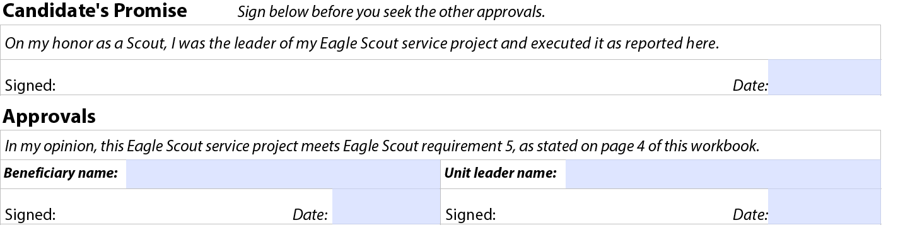
The Goal?
REQUIREMENT 5. While a Life Scout, plan, develop, and give leadership to others in a service project helpful to any religious institution, any school, or your community.
REQUIREMENT 7. Successfully complete an Eagle Scout board of review.
The applicant appeared before the Eagle Scout board of review on this date, and this application was approved.
Date
Signature of Eagle Scout board of review chair
Signature of council/district board representative (if applicable)

Slide 26
Questions and Answers

